Slide 1
Five Digital Classroom Tools for Innovative Teachers

Slide 2
Five Digital Tools
www.classtools.net
1. Cloze Quiz Generator - Fill in the Gaps
2. Arcade Game - Wordshoot Vocabulary
3. Image reveal tool
4. Crossword Generator
5. Drag and Drop" quiz generator

Slide 3
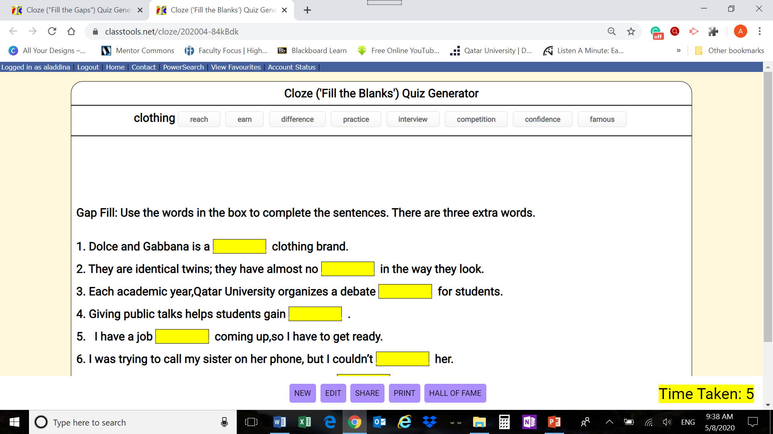
Cloze Quiz Generator - Fill in the Gaps
Interactive web-based exercises
An appealing piece of multimedia
Easy to create and share

Slide 4
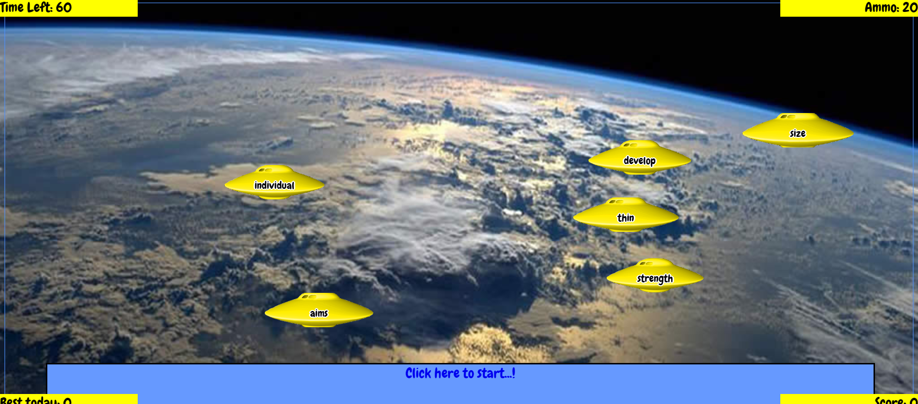
Arcade Game - Wordshoot Vocabulary
An entertaining vocabulary game
Hunting the right word

Slide 5
Image Reveal tool
Serves as a warm-up activity
Focuses on a key image or photo in the lesson
Can be played in groups

Slide 6
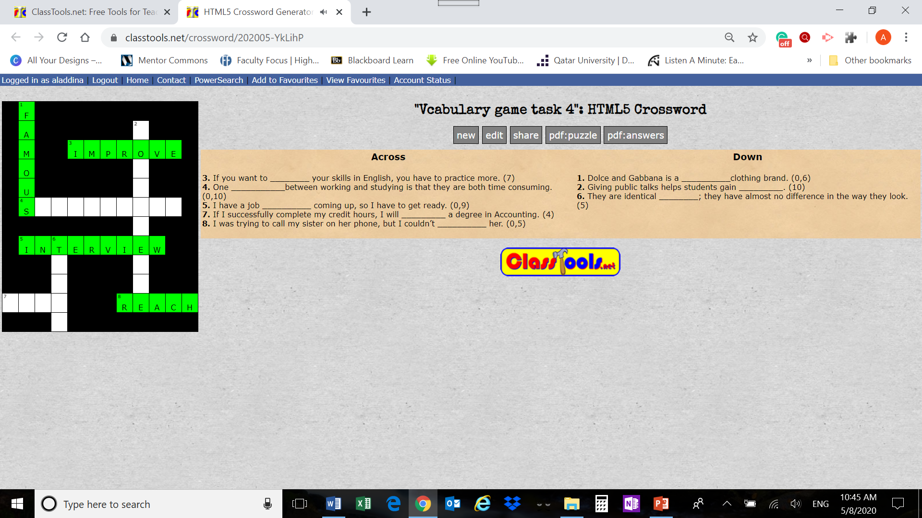
Crossword Generator
Guessing words from context
An appealing piece of multimedia

Slide 7
Drag and Drop quiz generator
An effective strategy for
logical reasoning
reading comprehension

Slide 8
Thank you Any questions?

