Slide 1
Age could be driving variable COVID-19 epidemic trajectories worldwide: Mathematical modeling analyses
Houssein Ayoub¹, Laith Abu-Raddad²
¹Department of Mathematics, Statistics, and Physics, Qatar University, Doha, Qatar
²Infectious Disease Epidemiology Group, Weill Cornell Medicine-Qatar, Qatar Foundation, Doha, Qatar

Slide 2
Rationale
An outbreak of a novel coronavirus strain, severe acute respiratory syndrome coronavirus 2 (SARS-CoV-2), was identified in Wuhan, Hubei province, China, in late December 2019.
Coronavirus Disease 2019 (COVID-2019) has been subsequently declared as a pandemic, after affecting most of countries and territories.
There is a need to inform national response:
  Investigating epidemiologic patterns
  Forecasting the future of the national epidemic
  Assessing epidemic potential
  Estimating healthcare needs and impact of interventions.

Slide 3
A fundamental concept in infectious disease epidemiology
The basic reproduction number (R₀)
Definition: the average number of new infections a typical infectious individual will cause at the start of the epidemic (in a completely susceptible population)
Measure of the intrinsic potential for an infectious agent to spread

Slide 4
The basic reproduction number (R₀)
T(0)
T(1)
T(2)
Pandemic influenza (R₀~2)
R₀ = 2
Transmission
Susceptible
Infectious
4

Slide 5
The basic reproduction number (R₀)
T(0)
T(1)
T(2)
Other infection (R₀= 0.5)
R₀ = 0.5
Transmission
Susceptible
Infectious
5

Slide 6
The basic reproductive number (R₀)
R₀ > 1 Infection spreads (epidemic)
R₀ < 1 Infection dies out
Threshold theory
Notes:
First round of infection transmission, second round of infection transmission etc
The epidemic can easily explode
R0
Influenza

Slide 7
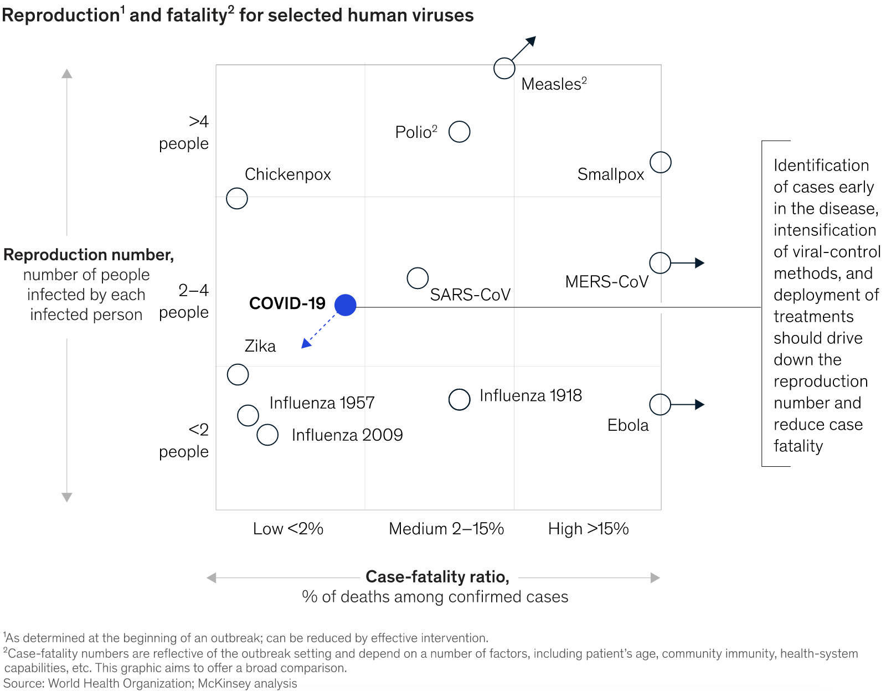

Slide 8
R₀ of COVID-19
Best estimates are ~2.0-2.6 (without intervention)
R₀ COVID-19
R₀ seasonal flu
Notes:
First round of infection transmission, second round of infection transmission etc
The epidemic can easily explode
R0
Influenza
This explains why there is so much concern globally.

Slide 9
COVID-19 disease progression based on China data
Critical
Respiratory failure, septic shock, and/or multiple organ dysfunction/failure
Severe
Dyspnea, respiratory frequency ≥30/minute, blood oxygen saturation ≤93%, PaO2/FiO2 ratio <300, and/or lung infiltrates >50% of the lung field within 24-48 hours
Mild to moderate
Non-pneumonia and pneumonia cases
Critical
6%
Seasonal flu:
1% hospitalization rate
Severe
14%
Mild to
moderate
80%
 | From: | To: | Duration
Mild/moderate | Onset of symptoms | Recovery | 2 weeks
Severe/critical | Onset of symptoms | Recovery | 3-6 weeks
Severe/critical | Onset of symptoms | Severe disease | 1 week
Deaths | Onset of symptoms | Death | 2-8 weeks
Report of the WHO-China Joint Mission on Coronavirus Disease 2019 (COVID-19), 16-24 February 2020.
(Data on 55,924 confirmed cases in China)
Notes:
This is an analysis of 56,000 confirmed cases in China. Largest we have so far.
Great news is that most people will have a mild infection, just like usual cold.
Disease severity is about 20 times as high as seasonal influenza, typically of 1% in past seasons.
Half of the critical are dying 49%
It is important to realize that it takes easily as long as 8 weeks before those critical die out.
The delay between onset of symptoms and hospitalizations (1 week) is a window of opportunity for clinical intervention

Slide 10
Adopted Approach
  We used and adapted a set of mathematical models developed over several NPRP projects. These models include both deterministic compartmental models and stochastic models to investigate the epidemiology of COVID-19 and to forecast the future of the epidemic, assess epidemic potential, and estimate healthcare needs and impact of interventions.

Slide 11
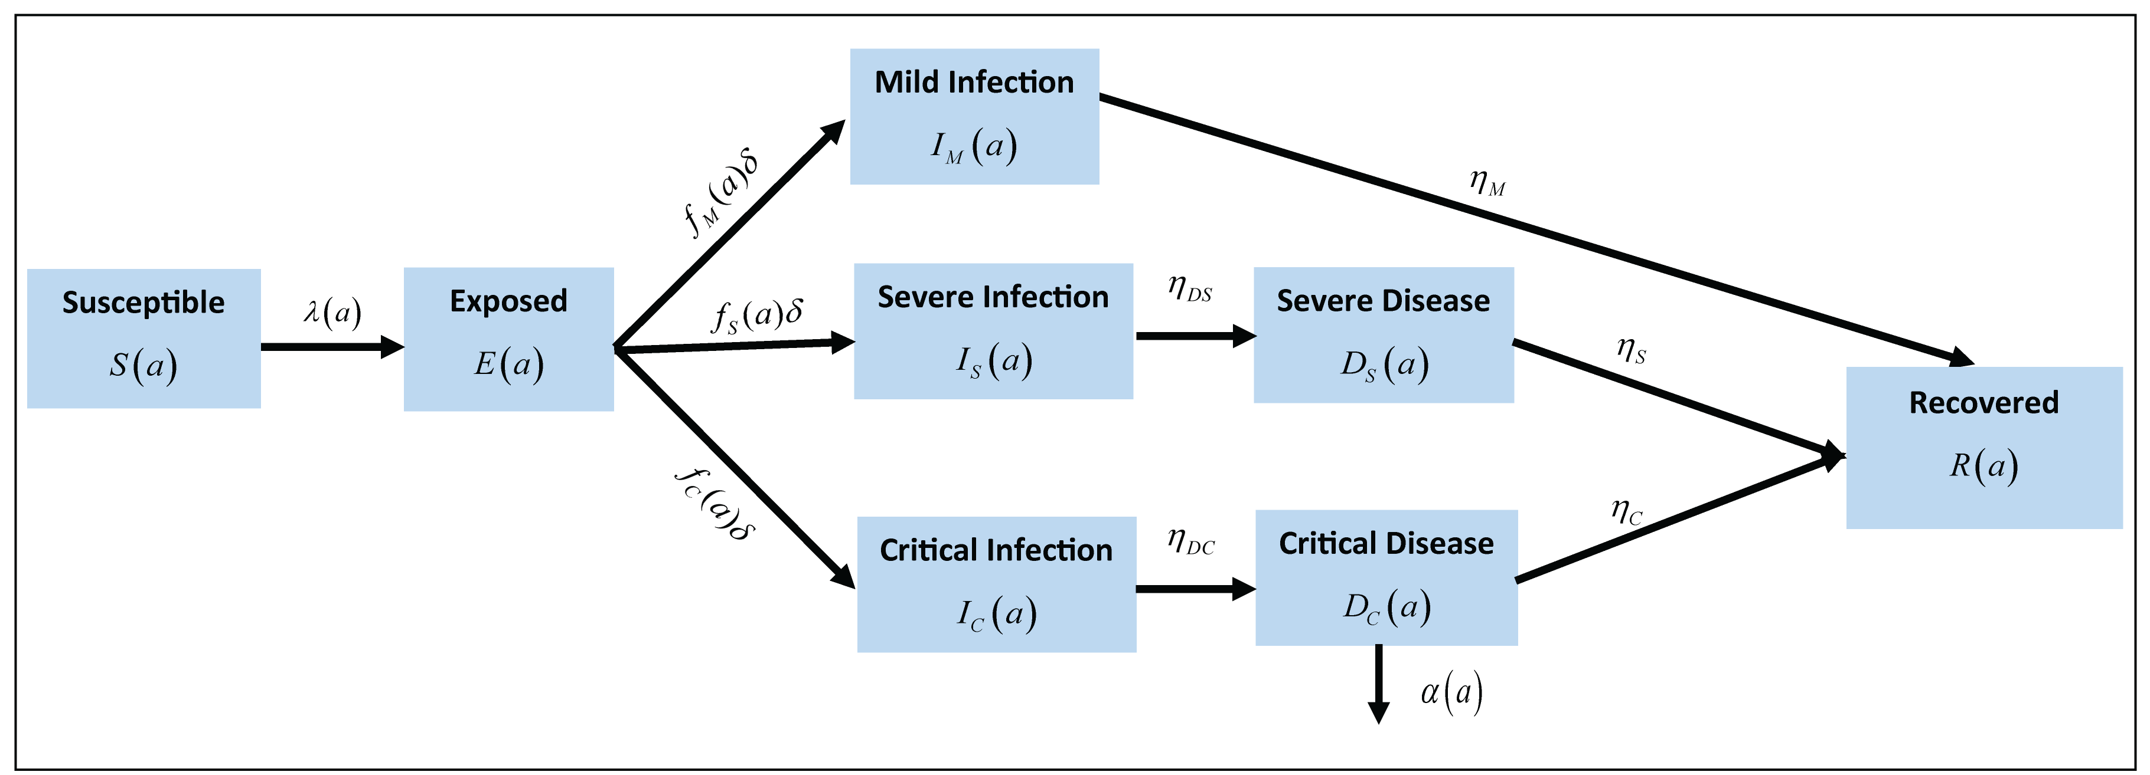
Schematic diagram describing the basic structure of the COVID-19 model

Slide 12
Nonlinear Age-Structured Mathematical Model

Slide 13

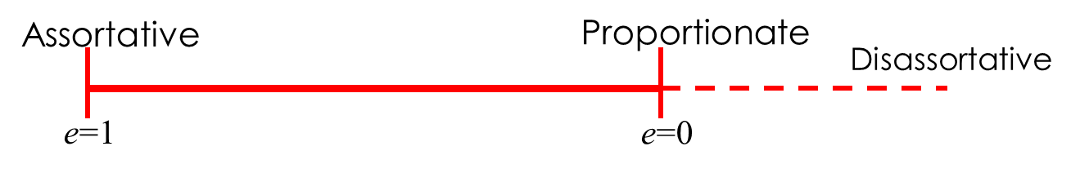
Force of Infection (Rate of Infection)
Contact rate
Mixing
matrix
Fraction of available infected people who are in contact with the susceptible people
Susceptibility to the infection
The mixing among the different age groups:

Slide 14
Basic Reproduction Number R0

Slide 15
Key known Parameters

Slide 16
Unknown Parameters:

Slide 17


Estimation of the Unknown Parameters
Model fits were implemented in MATLAB® using a nonlinear least-square fitting method.

Slide 18
Model Fitting to China data

Slide 19
Results
Characterizing key attributes of the epidemiology of COVID-19

Slide 20
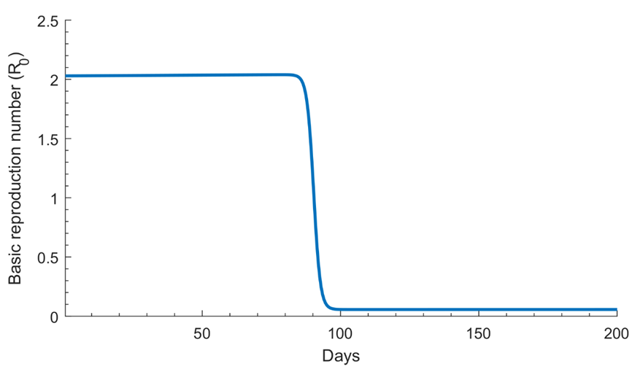
Time evolution of the basic reproduction number R0 before and after onset of interventions in China

Slide 21
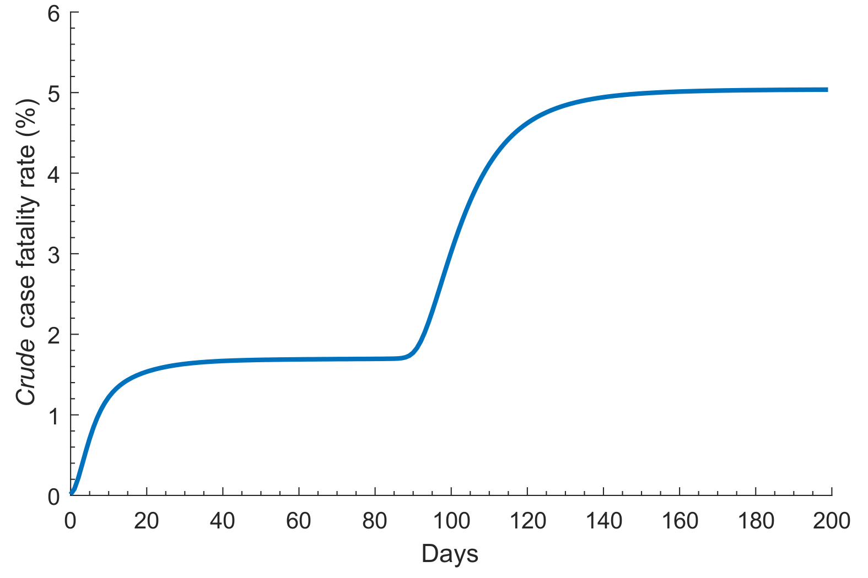
Mortality rate in China

Slide 22
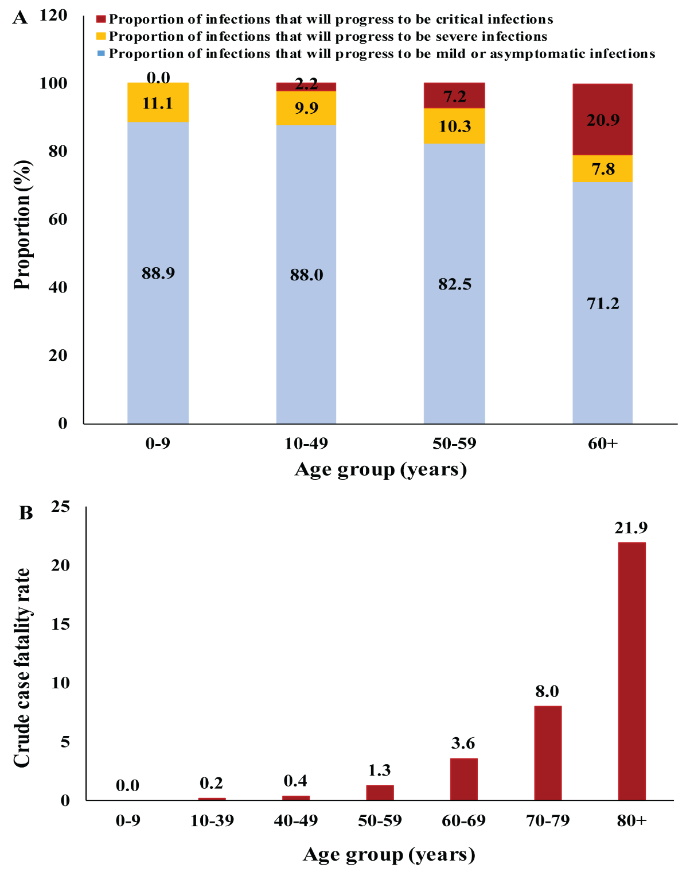
SARS-CoV-2 disease progression stratified by age

Slide 23
Estimated Parameter
Degree of assortativeness in infection transmission mixing by age in China
Notes:
Makes sense for a household transmission; about 80% in China

Slide 24
Estimated Parameter
Age-stratified susceptibility profile to COVID-19 infection, relative to those 60-69 years of age
Notes:
Based on the China epidemic
Opposite to influenza

Slide 25
Results
What is the role of age in driving COVID-19 epidemic trajectories worldwide?

Slide 26
In worst-case scenario (without any restrictions and/or lock-down)…

Slide 27
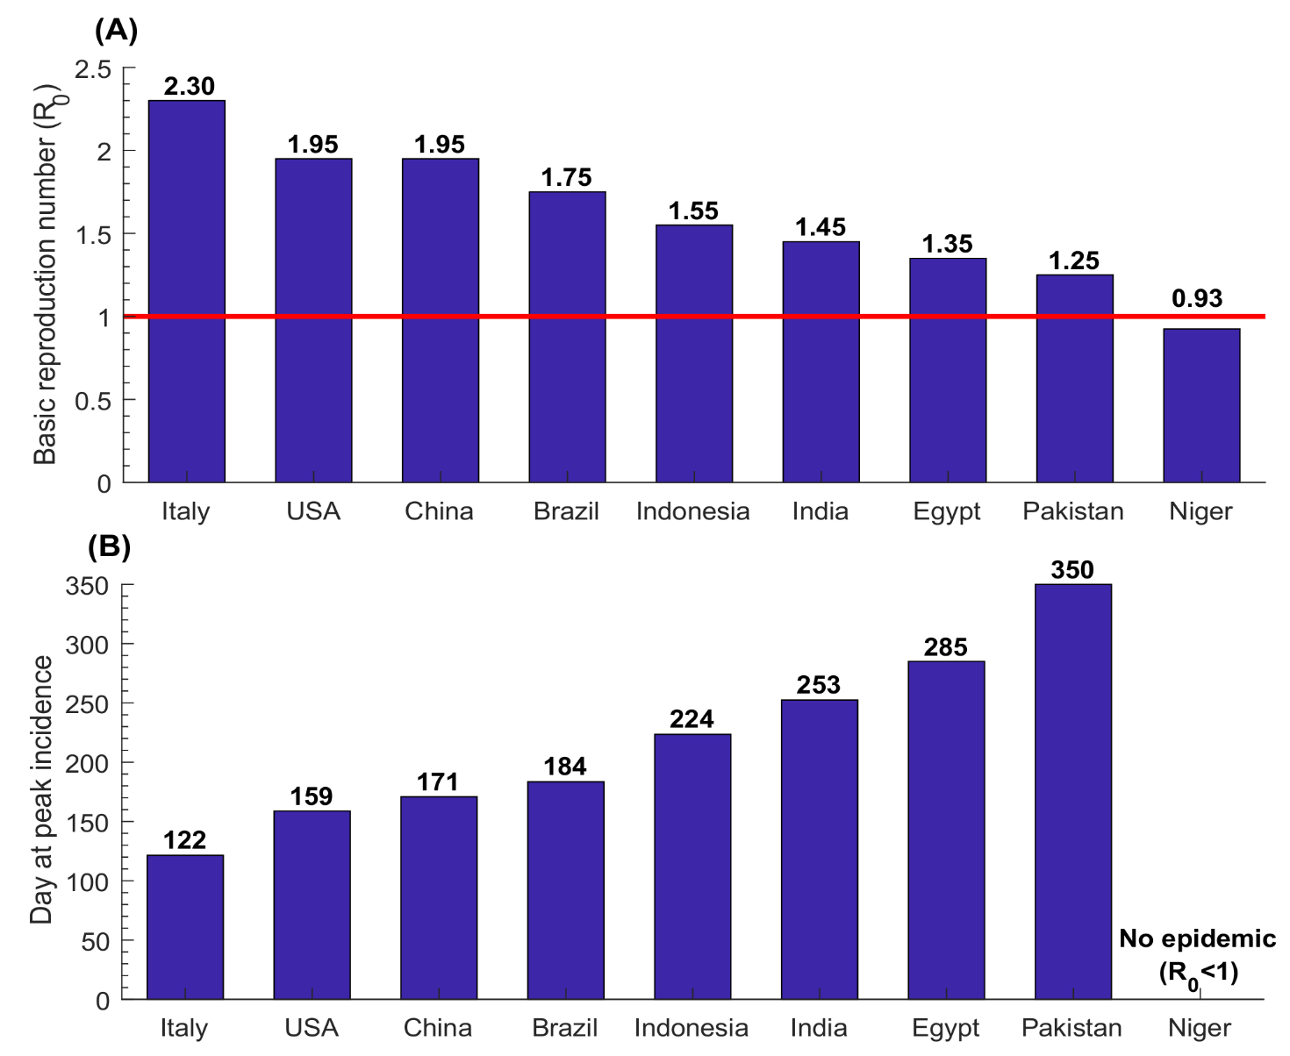
Estimates for the basic reproduction number R0 in select countries

Slide 28
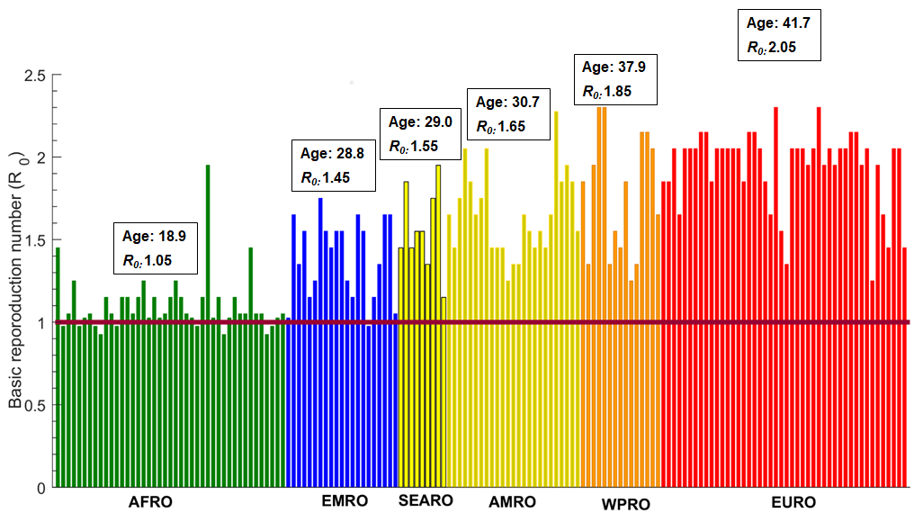
Estimates for the basic reproduction number R0 globally
Notes:
Makes sense for a household transmission; about 80% in China

Slide 29
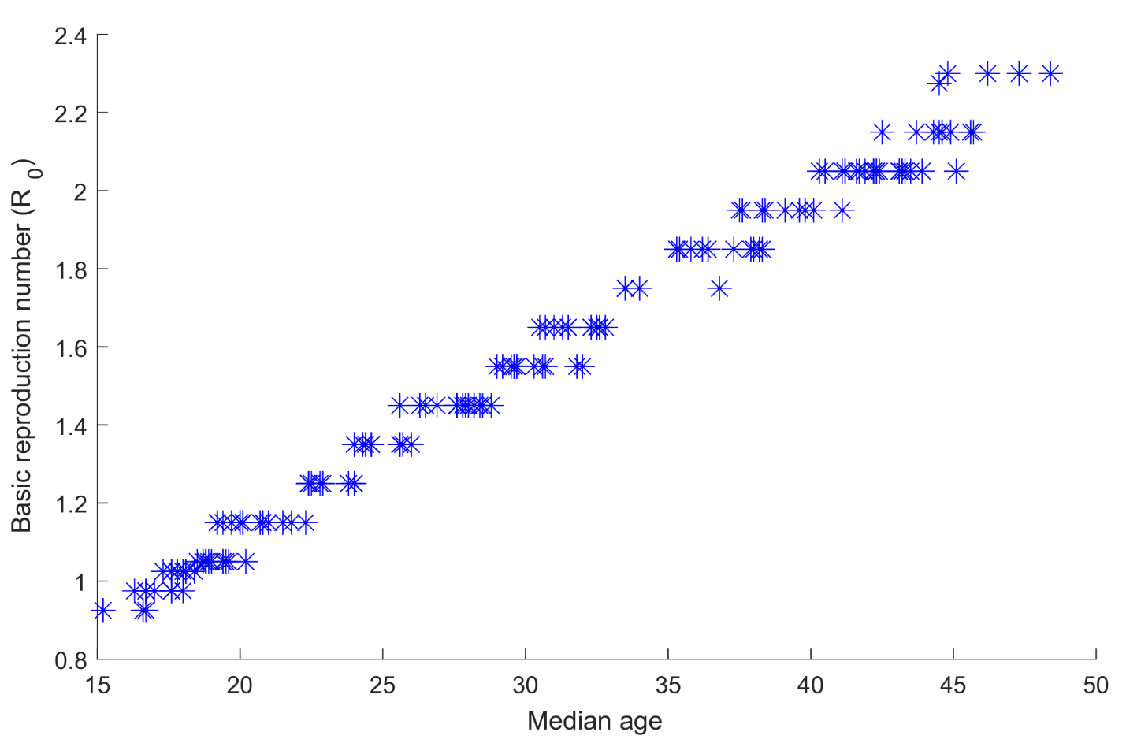
Impact of the variation in median age across countries
Notes:
Makes sense for a household transmission; about 80% in China

Slide 30
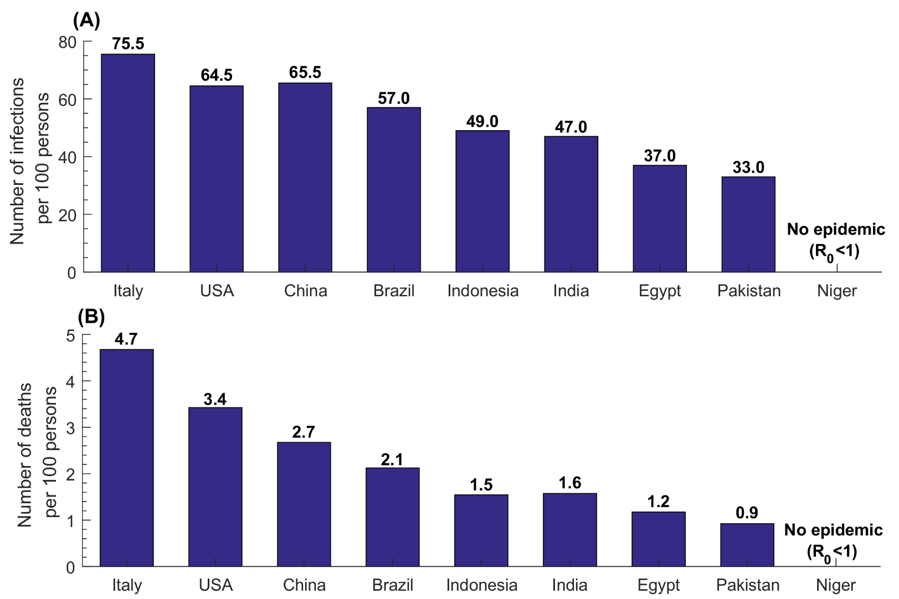
Estimates for the number of infections and the number of deaths per 100 persons in select countries
Notes:
Makes sense for a household transmission; about 80% in China

Slide 31
Results
The impact of vaccination:
The case for China

Slide 32
Results
Impact of a partially efficacious vaccine: Vaccine scale up before epidemic emergence
Notes:
Vaccine impact is more complicated than it may seem. It might be partially efficacious. It may have also different efficacies.
May not be sufficient to contain the infection. But it will reduce the scale and delay the epidemic, thereby relieving healthcare. We still need social distancing measures, but not as severe

Slide 33
Results
Impact of a partially efficacious vaccine: Vaccine scale up after epidemic emergence
Notes:
Vaccine impact is more complicated than it may seem. It might be partially efficacious. It may have also different efficacies.

Slide 34
Results
Impact of a partially efficacious vaccine: Vaccine efficacy needed to control the infection
Notes:
Vaccine impact is more complicated than it may seem. It might be partially efficacious. It may have also different efficacies.

Slide 35
Results
Impact of a partially efficacious vaccine: Vaccine effectiveness by age groups
Notes:
Who is going to get the vaccine first
On balance, it best for the elderly
Vaccine impact is more complicated than it may seem. It might be partially efficacious. It may have also different efficacies.

Slide 36
Conclusion
COVID-19 is a concerning virus with high transmission potential and potentially severe disease morbidity and mortality, worldwide.
However, we are in a different world to that during the Spanish flu where we have experienced a similar scale threat.
We will prevail at much less damage, but this can only be done with collective responsibility.
Countries with sizable adult and/or elderly populations and smaller children populations may experience large and rapid epidemics in absence of interventions.
A vaccine may not be difficult to develop, given that the immune system is already successful in clearing most infections
Vaccine efficacy (or coverage) does need to be very high to eliminate the virus completely - a partially efficacious vaccine is good enough

Slide 37
References:
Ayoub, H. H., Chemaitelly, H., Mumtaz, G. R., Seedat, S., Awad, S. F., Makhoul, M., & Abu-Raddad, L. J. (2020). Characterizing key attributes of the epidemiology of COVID-19 in China: Model-based estimations. medRxiv.
Ayoub, H. H., Chemaitelly, H., Seedat, S., Mumtaz, G. R., Makhoul, M., & Abu-Raddad, L. J. (2020). Age could be driving variable SARS-CoV-2 epidemic trajectories worldwide. medRxiv.
Makhoul, M., Ayoub, H. H., Chemaitelly, H., Seedat, S., Mumtaz, G. R., Al-Omari, S., & Abu-Raddad, L. J. (2020). Epidemiological impact of SARS-CoV-2 vaccination: mathematical modeling analyses. medRxiv.
Mumtaz, G. R., Ayoub, H. H., Chemaitelly, H., Seedat, S., Mumtaz, G. R., Al-Omari, S., & Abu-Raddad, L. J. (2020). Can the COVID-19 pandemic still be suppressed? Putting essential pieces together. Journal of Global Health Reports.
Notes:
Just some of the results

Slide 38


Acknowledgment
This work was made possible by NPRP12S-0216-190094 from the Qatar National Research Fund (a member of Qatar Foundation). The statements made herein are solely the responsibility of the authors. The authors are also grateful for the support provided by the Biomedical Research Program at Weill Cornell Medicine-Qatar.

