Slide 1


Math Game: Fun Fridays
Ryad Ghanam
VCU Qatar
FP Virtual Academic Excellence Days
Spring 2020
May 14, 2020
© Ryad Ghanam

Slide 2
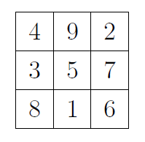
Game 1: Magic Square
A Magic Square is a 3 by 3 array of numbers that has a Magic Sum, S, such that the this sum equals the sum of the numbers in each row, in each column, and along each diagonal.
In this case, S=15.
© Ryad Ghanam

Slide 3
Example:
 |  | 1
5 |  | 6
Can the above square be completed into a magic square?
If the square can be completed, then can it be completed uniquely?
If the square can be completed, then how can we complete it?
© Ryad Ghanam

Slide 4
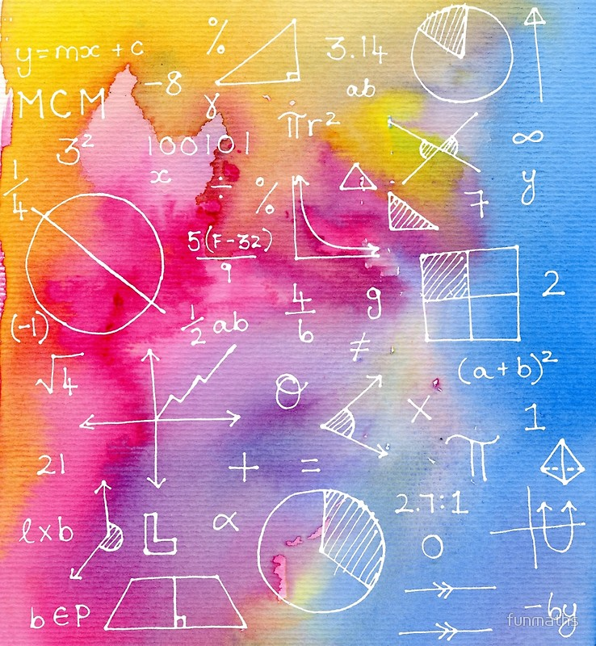
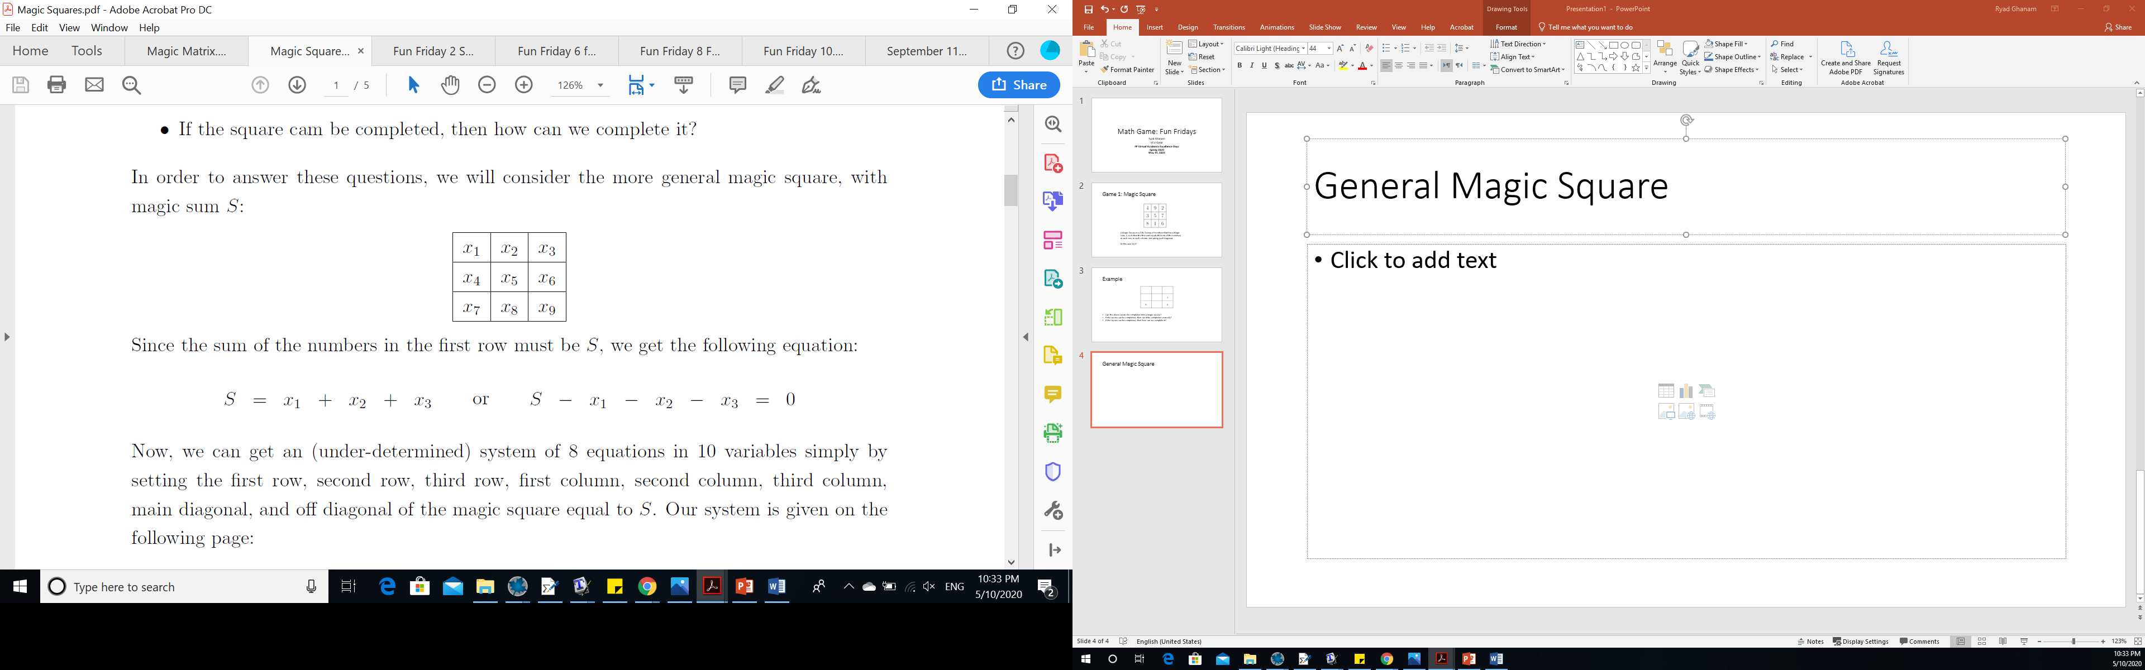
General Magic Square
S=sum
© Ryad Ghanam

Slide 5
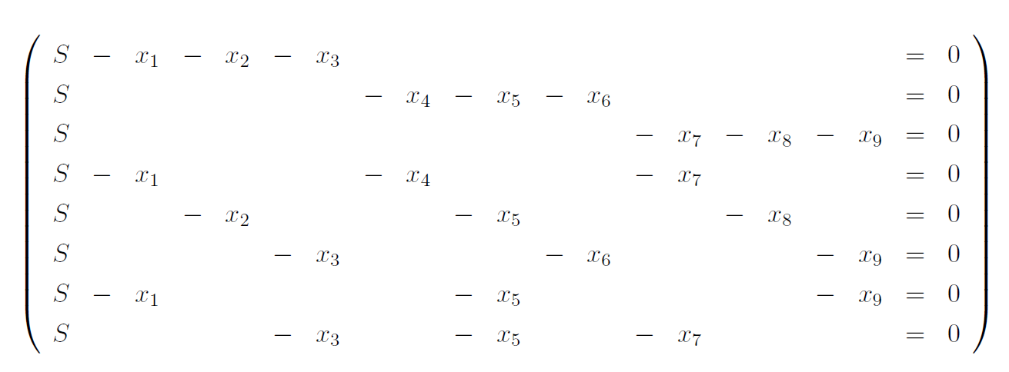
System
© Ryad Ghanam

Slide 6
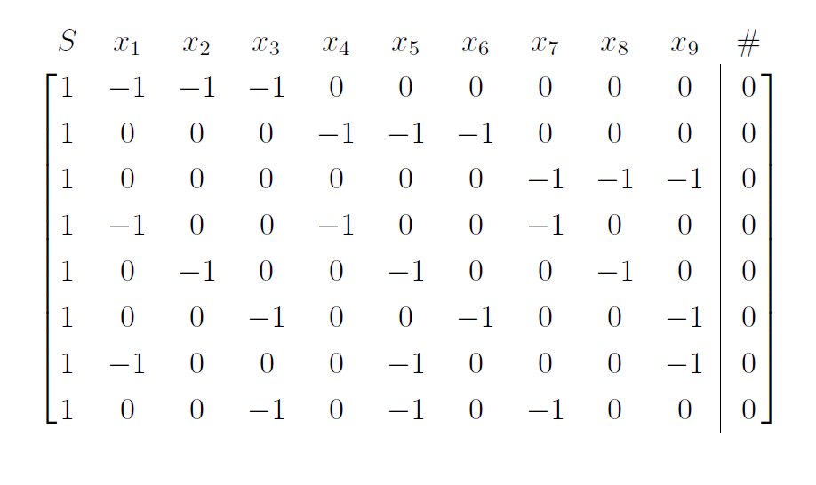
The augmented matrix
© Ryad Ghanam

Slide 7
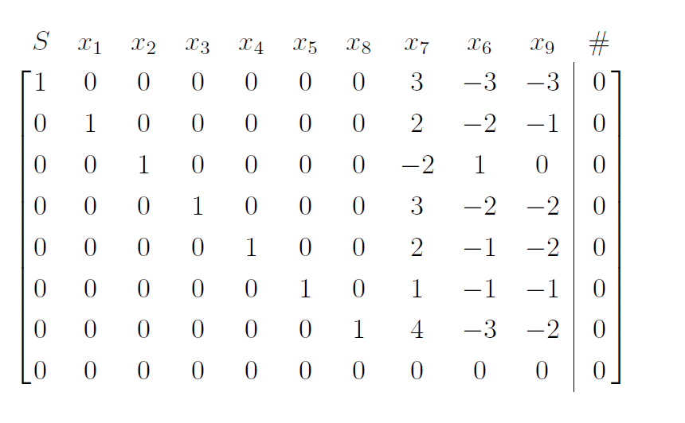
r.r.e.f
© Ryad Ghanam

Slide 8

Solution
© Ryad Ghanam

Slide 9
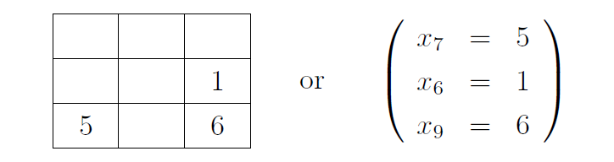
Going back to the example
© Ryad Ghanam

Slide 10
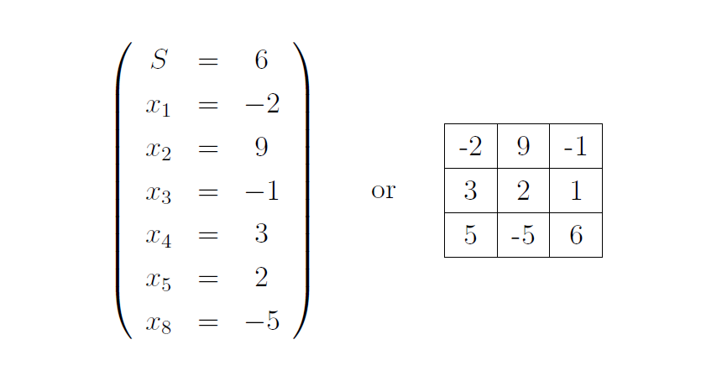
Example (Continued)
© Ryad Ghanam

Slide 11
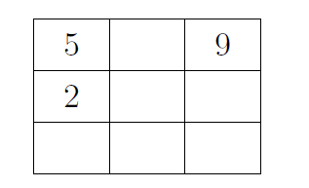
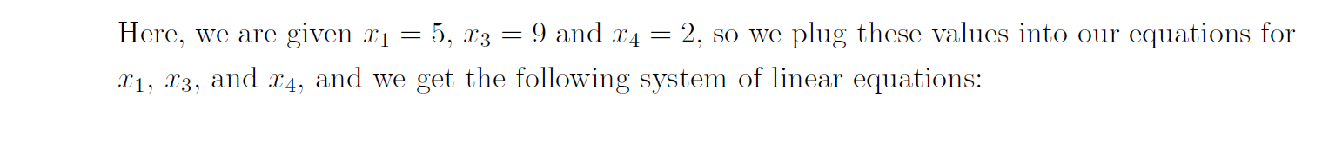
Example : Solve the following Magic Square
© Ryad Ghanam

Slide 12
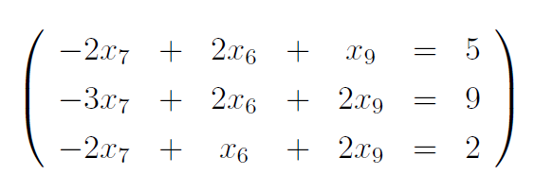
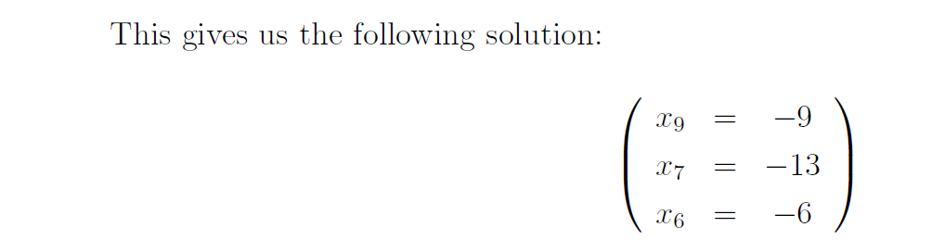
© Ryad Ghanam

Slide 13

© Ryad Ghanam

Slide 14
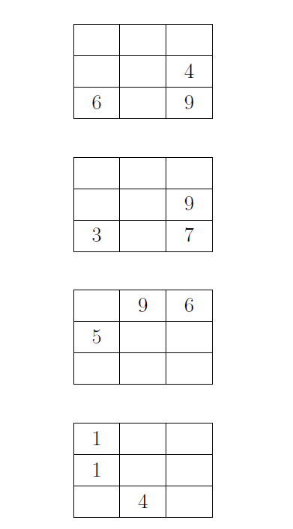
More Examples
© Ryad Ghanam

Slide 15

© Ryad Ghanam

Slide 16
SET Game
SET: is a card game that has 81 cards. Each card has four features: color, filling, number and shape. The possible colors, filling, numbers and shapes are:
Color: Green, Purple, Red
Filling: Hollow, Shaded, Solid
Number: One, Two, Three
Shape: Diamond, Oval, Squiggle
© Ryad Ghanam

Slide 17
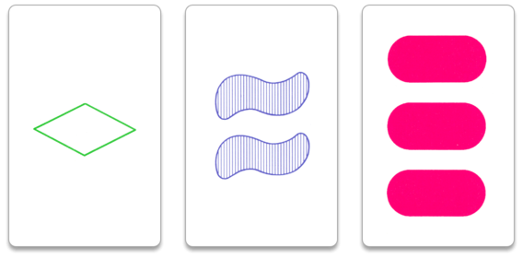
There are: 3x3x3x3=81 cards
© Ryad Ghanam

Slide 18
A SET of cards {a,b,c} such that all four of the following statements are true:
1. Either all 3 cards have the same color or all 3 cards have different colors
2. Either all 3 cards have the same number or all 3 cards have different numbers
3. Either all 3 cards have the same shape or all 3 cards have different shapes
4. Either all 3 cards have the same filling or all 3 cards have different fillings
© Ryad Ghanam

Slide 19
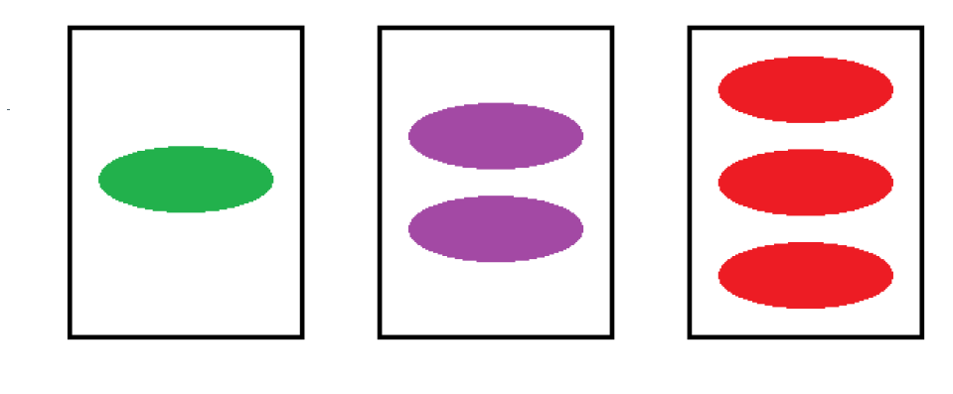
Example:
The following three cards form a SET.
© Ryad Ghanam

Slide 20
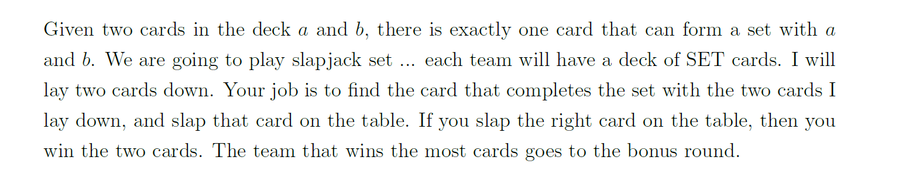
© Ryad Ghanam

Slide 21
We define a binary operation on the set of cards by saying that if a and b are cards, a * b = c if and only if {a,b,c} is a SET.
This binary operation is commutative, but not associative. (Show that)
I give the students 3 cards and I ask them to calculate
( a*b)*c and a*(b*c)
© Ryad Ghanam

Slide 22
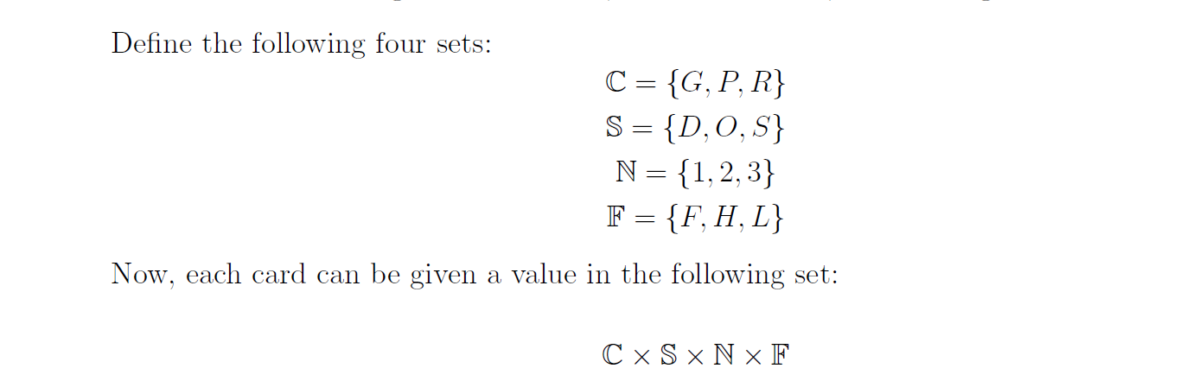
Another activity with SET: Direct Product
© Ryad Ghanam

Slide 23

© Ryad Ghanam

Slide 24
We now play the game again, but all of the cards are face down, so we can only see the labels.
© Ryad Ghanam

Slide 25
Jeopardy
Jeopardy! is an American television game show created by Merv Griffin. The show features a quiz competition in which contestants are presented with general knowledge clues in the form of answers, and must phrase their responses in the form of questions.
© Ryad Ghanam

