Slide 1
Perceived Levels of Critical Thinking Competences
&
Preference of Learning Platforms
Assoc Prof Dr. Madhubala A/P Bava Harji
Multimedia University
Malaysia

Slide 2
CONTENT
Top 10 Important Skills at Workplace
Description of Study
Results
MMU T & L Platform
Students’ Preferred Methodology/Educational Tools/Resources/App to Develop CT
Resources/Tools/App for Teachers

Slide 3
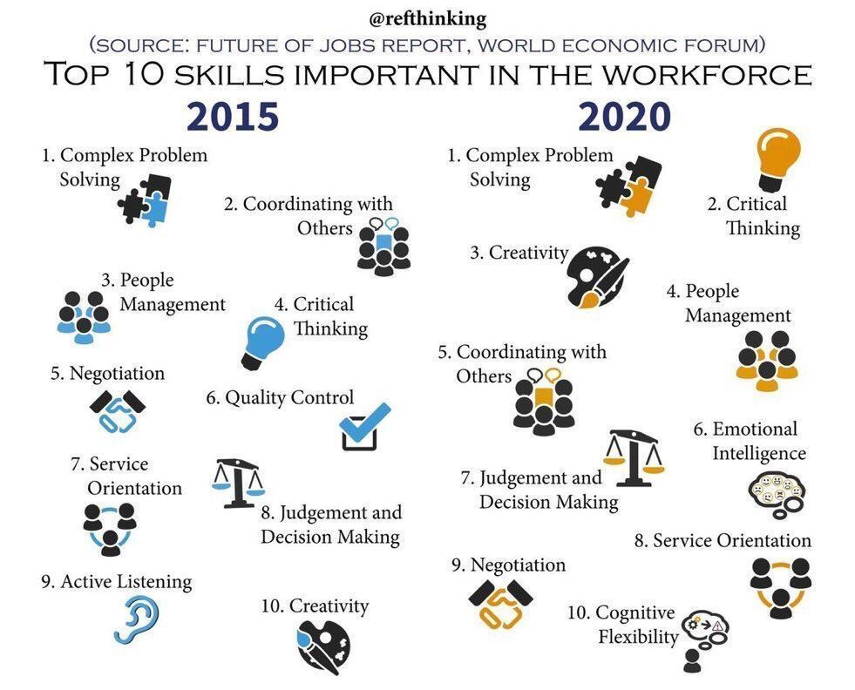

Slide 4
Description of Study

Slide 5
Objective of Study
To identify students’:
Self Identity as Critical Thinkers
Perceived Competence Level of CT
Preferred Learning Platform

Slide 6
Place of study: Multimedia University
(1st private university in Malaysia)
No of participants: 200 students
Level of Study: Foundation year
Focus : Data Analysis by Field of Study & Gender

Slide 7
Field of Study
IT/Computer Science/ Engineering | Technical
Management/Business/Law/ Accounting/Communication | Non Technical

Slide 9
Gender

Slide 10
Instruments
Questionnaire
Sections:
Self Identity as Critical Thinkers
Perceived Competence Level of CT
Preferred Learning Platform
Activities that Developed Students’ CT Ability
Adopted from Bezanilla, et al., (2019), Celuch, et al. (2008) & Orszag, A. (2015),
Reliability of Instrument: Cronbach Alpha - 0.964

Slide 11
Self Identity as Critical Thinkers

Slide 12
Critical Thinking
Importance
Self-Rating

Slide 13
How important is critical thinking to you?
8%
82%

Slide 14
How would you rate your critical thinking ability?
22%
78%

Slide 15
Descriptive Statistics
 | Mean | SD
How important is critical thinking to you? | 3.94 | 0.93
How would you rate your critical thinking ability? | 3.09 | 0.91

Slide 16
Independent Sample T-Test (by Gender)
 | Gender | N | Mean | Std. Deviation | Std. Error Mean
How important is critical thinking to you? | Male | 91 | 3.86 | 1.01 | 0.11
 | Female | 109 | 4.01 | 0.84 | 0.08
How would you rate your critical thinking ability? | Male | 91 | 3.1 | 0.97 | 0.10
 | Female | 109 | 3.08 | 0.86 | 0.08

Slide 17
Independent Sample T-Test (by Field of Study)
 | Field of Study | N | Mean | Std. Deviation | Std. Error Mean
How important is critical thinking to you? | Technical | 56 | 3.91 | 0.92 | 0.12
 | Non-Technical | 144 | 3.95 | 0.93 | 0.08
How would you rate your critical thinking ability? | Technical | 56 | 3.2 | 0.94 | 0.12
 | Non-Technical | 144 | 3.05 | 0.95 | 0.08

Slide 18
Self-Identity as Critical Thinker
 | N | Mean | Std. Deviation
Broadminded Thinker | 200 | 5.61 | 1.202
Deep Thinker | 200 | 5.28 | 1.245
Clear Thinker | 200 | 5.21 | 1.332
Accurate Thinker | 200 | 5.15 | 1.493

Slide 19
Perceived Levels
of
Critical Thinking Competence

Slide 20
Descriptive Statistics: Perceived Levels of CT Competence
Skills |  |  |  |  | Disposition/Inherent Qualities
 | Mean | Std. Deviation |  |  |  | Mean | Mean | Std. Deviation
Inference | 3.83 | 0.70 |  |  | Inquisitiveness | 3.8925 | 3.9 | 0.69
Self-Regulation | 3.87 | 0.71 |  |  | Open-Mindedness | 3.785 | 3.85 | 0.64
Interpretation | 3.76 | 0.74 |  |  | Maturity | 3.7033 | 3.70 | 0.62
Evaluation | 3.76 | 0.82 |  |  | Analyticity | 3.665 | 3.67 | 0.67
Analysis | 3.73 | 0.79 |  |  | Systematicity | 3.6475 | 3.65 | 0.71
Explanation | 3.73 | 0.81 |  |  | Truth-Seeking | 3.615 | 3.61 | 0.67
 |  |  |  |  | Self-Confidence | 3.53 | 3.53 | 0.76

Slide 21
Mann-Whitney Test Gender Difference {Skills)
 | Male | Female | df | Mann-Witney U | Wilcoxon W Z | Assumed Sig (2 tailed) p
 | (n=91) | (n=109)
 | Mean Rank | Mean Rank
Interpretation | 111.23 | 91.54 | 198 | 3983 | -2.421 | 0.015
Analysis | 111.24 | 91.53 | 198 | 3982 | -2.454 | 0.014
Evaluation | 107.34 | 94.79 | 198 | 4337.5 | -1.574 | 0.116
Inference | 108.73 | 93.63 | 198 | 4210.5 | -1.884 | 0.06
Explanation | 107.27 | 94.85 | 198 | 4343.5 | -1.557 | 0.12
Self-Regulation | 108.84 | 93.54 | 198 | 4201 | -1.901 | 0.057

Slide 22
Mann-Whitney Test : Gender Difference {Disposition/Inherent Qualities)
 | Male | Female
Disposition / Inherent Qualities | (n=91) | (n=109) | df | Mann-Witney U | Wilcoxon W Z | Assumed Sig (2 tailed) p
 | Mean Rank | Mean Rank
Inquisitiveness | 106.54 | 95.46 | 198 | 4410 | -1.379 | 0.168
Systematic | 106.89 | 95.17 | 198 | 4378 | -1.466 | 0.143
Analytic | 105.42 | 96.39 | 198 | 4511.5 | -1.115 | 0.265
Truth-Seeking | 111.32 | 91.47 | 198 | 3975 | -2.458 | 0.014
Open-Mindedness | 107.24 | 94.87 | 198 | 4346 | -1.532 | 0.126
Self-Confidence | 114.1 | 89.14 | 198 | 3721.5 | -3.117 | 0.002

Slide 23
Course Delivery
in
MMU
70 – 30 Mixed Delivery

Slide 24
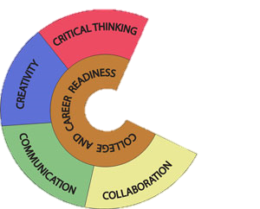
Objectives
To provide better teaching & learning experiences
To reinforce MMU i-University key initiatives
To ensure students are competent with 21st Century learning skills
21st Century
Learning Skills

Slide 25
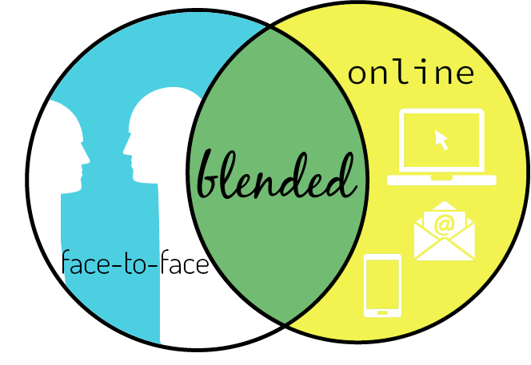

Slide 26
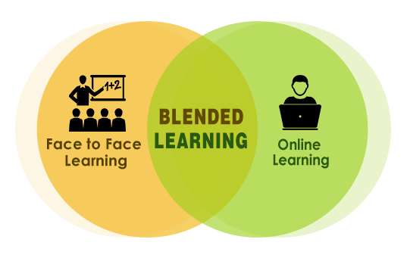
What is Blended Learning?
“Integrating online activities with face-to-face class teaching in planned, pedagogical & valuable manner”
Online activities: Using web tools to create a positive learning experience
BL is mandatory in T&L as per our syllabus and
it is aligned to Education 4.0.
Face-to-face teaching: Learning with the instructor present
Integrating: To make it a part of the teaching strategy

Slide 27
Calculation of Student Learning Time
Credit Hour | Guided Learning (F2F) Lecture (70%) | Guided Learning (Non F2F) BL / Online (30%) | Independent Learning (Non F2F) Derived from Lecture | Total Student Learning Time*
2 (2x14wks = 28hrs) | 19 | 9 (+9) = 18 | 19 | 56
3 (3x14wks = 42hrs) | 29 | 13 (+13) = 26 | 29 | 84
4 (4x14wks = 56hrs) | 39 | 17 (+17) = 34 | 39 | 112

Slide 28

BLENDED LEARNING ROADMAP
Commencement 2016

Slide 29
MMU Blended Learning Structure
30%
of total subjects by 2016
70%
of total subjects by 2017
100%
subjects by 2018
All subjects are required to implement 30% blended learning
30% of all subjects are required to implement 30% blended learning
70% of all subjects are required to implement 30% blended learning

Slide 30
LESSON PLAN
WEEK | DATE | TOPICS | Activities (Hours) |  |  |  | REMARKS (Class Replacement/ Public Holiday)
 |  |  | E-Learning | Lecture | Tutorial | Lab
 | 2 July - 8 July 2018 | Introduction to Social Research Definition of research; Applied and basic research; Hallmarks of Scientific …… [3hrs] |  | Lecture [3]
2. | 9 July - 15 July 2018 | Introduction to Social Research Characteristics and types [1hr] The Research Process Definition of problem; Literature review; … [1hr] | Blended Learning [1] | Lecture [1]
3. | 16 July - 22 July 2018 | The Research Process Hypothesis development; Research design; …[1hr] Data collection [1hr] | Blended Learning [1] | Lecture [1] |  |  | Quiz (In Class)

Slide 31
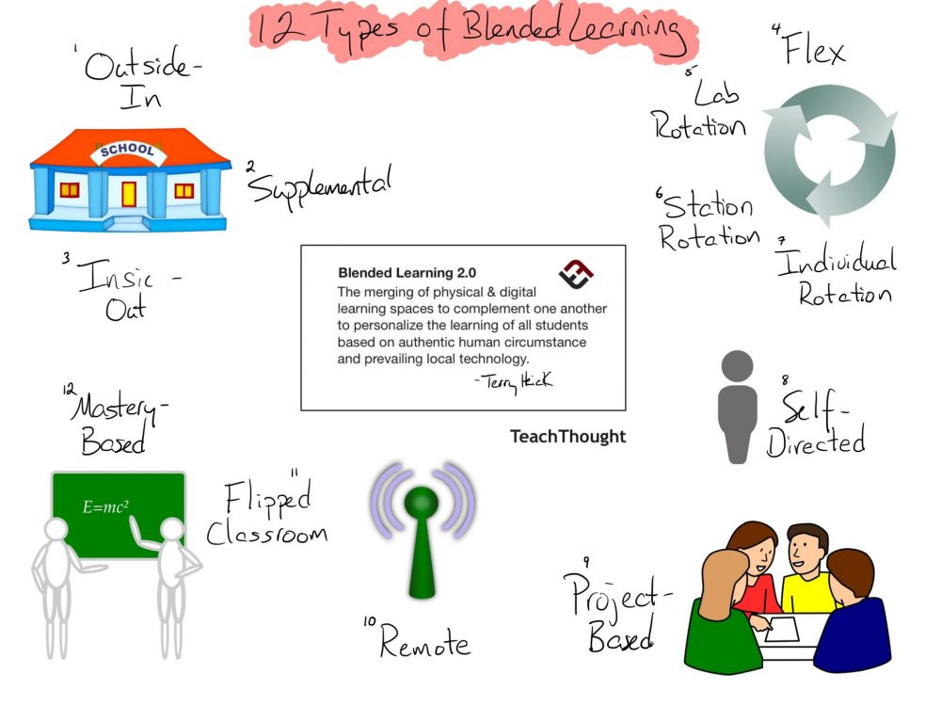

Slide 32
Official MMU Teaching & Learning Platforms
MMLS, Blogs, G-Suite for Education

Slide 33

Announcement
Lecture Notes
Assignment Submission
Wordpress (blogs)
Discussion board
Quiz/Exercise
Embedded Videos/ Content
QR Code Attendance

Slide 34


Slide 35

















Google Apps

Slide 36
Learning Approach

Slide 37
Effectiveness of Course Delivery in
Developing CT
 | Mean | Std. Deviation
Face to Face | 3.93 | 1.005
Blended Learning | 3.91 | 1.113
Flipped learning | 3.41 | 1.551

Slide 38
T-Test
 | Gender | N | Mean | Std. Deviation | Std. Error Mean
Face to Face | Male | 91 | 3.93 | 1.073 | .112
 | Female | 109 | 3.93 | .950 | .091
Blended Learning | Male | 91 | 3.85 | 1.229 | .129
 | Female | 109 | 3.96 | 1.009 | .097
Flipped learning | Male | 91 | 3.24 | 1.753 | .184
 | Female | 109 | 3.56 | 1.350 | .129

Slide 39
Studnets’ Preferred
Methodology
Tools/Resources/App
to Develop CT

Slide 40
Effectiveness of Methodology (F2F) in Developing CT
(Bezanilla, et al., (2019), Methodologies for teaching-learning critical thinking in higher education: The teacher’s view)
 | Mean | Std. Deviation
Problem solving (Problem and project-based learning) | 3.81 | 1.38
Questions and enquiries | 3.74 | 1.34
Evaluation, interpretation and justiﬁcation | 3.7 | 1.39
Questioning | 3.67 | 1.28
Case Study | 3.63 | 1.40
Collaborative and cooperative work | 3.62 | 1.40
Reading, analysis, and synthesis of resources (written, graphics, audio-visuals, etc) | 3.6 | 1.34
Feedback | 3.58 | 1.44
Real World Activities | 3.57 | 1.59
Writing assignments | 3.53 | 1.29
Oral Presentations | 3.55 | 1.32
Reading assignment | 3.55 | 1.28
Research project | 3.44 | 1.65
Oral and written reﬂection and argumentation | 3.41 | 1.489
Debates | 3.34 | 1.56
Drama | 3.25 | 1.52

Slide 41
Other Methods
Watch Thoughts-Provoking Movies,
Reasoning Game
Thinking & Answering Many Logical Questions Like Mathematics!
Projects
Solving Assignments
Organising Events
Argument in the Meeting
When You Have to Think on Your Feet
When Do Difficult Task
Brainstorming/
Group Discussions
Any Activities When I'm Leading People
Making Conclusion
Group Assignment

Slide 42
Educational Tool/Resources/Apps
 | Mean | Std. Deviation
Quizizz | 4.29 | .672
Kahoot | 4.25 | .657
MMLS | 4.22 | .877
GSuite for Education (google classroom) | 3.39 | 1.338
Edpuzzle | 3.27 | 1.424
Padlet | 3.14 | 1.522
Socrative | 3.08 | 1.423
Khan Academy | 2.98 | 1.577
Twitter | 2.93 | 1.459
TED-Ed | 2.84 | 1.503
Broadcast | 2.77 | 1.584
Blendspace | 2.76 | 1.562
Facebook | 2.72 | 1.600
Moodle | 2.65 | 1.533
YouTube | 2.64 | 1.574
Edomodo | 2.60 | 1.577

Slide 43
Reddit (A network of communities based on people's interests)
Thoughts Provoking Movies
Plague (A real-time strategy simulation video game)
Udemy ( An online learning platform aimed at professional adults & students)
IQ based Games
Brain game
LINE (A comm app: Free Calls & Messages)
Remind101 (Communication Platform)
Whatsapp
Online Learning Exchange
BBC /Google News
Wechat
Highlight Every Day
Instagram
Photomath (An app for Learning Maths)
Wei Bo
(Microblogging in China / China-based microblogging services)
Quora (A platform to ask questions & connect with people who contribute insights & answers)
TikTok (Video-sharing social networking service )
QuizUp
(A Multiplayer trivia game)
Whooo's reading (A Reading Website)
A Clockwork Brain (fun puzzles to train your brain)
Newsela (Instructional Content Platform for reading engagement & learning)
Wix Blog
(Blogging platform)

Slide 44
Resources/Tools/App for Teachers

Slide 45
Community Tools

Slide 46
Knowledge Tools

Slide 47

Learner-Centered
Tools

Slide 48
Assessment Tools

Slide 49
Implication
In a technologically powered environment - F2F is equally favoured.
Adoption of mix-methodology of blending the teaching & learning is essential.
Student centered - with students suggesting teaching approaches that best suits them.

Slide 50
I look forward in conducting a collaborative research, i.e. in comparing the your students’ perceived levels of CT competencies & preferred learning methodology Or in other area.
Let’s discuss.
Email: madhu7560@gmail.com
Whatsapp: +60193511131

Slide 51
Reference
Bezanilla, M.J., Fernandez-Nogueira, D., Poblete. M., and Galindo-Domínguez, H. (2019), Methodologies for teaching-learning critical thinking in higher education: The teacher’s view. Thinking Skills and Creativity, Vol. , https://doi.org/10.1016/j.tsc.2019.100584
Celuch, et al. (2008), Student Self-Identity as a Critical Thinker: The Influence of Attitudes, Attitude Strength, and Normative Beliefs, Journal of Marketing Education, 31 (1) .pp 31-39. https://doi.org/10.1177/0273475308324088
Orszag, A. (2015), Exploring Finnish university students' perceived level of critical thinking, http://urn.fi/URN:NBN:fi:jyu-201505252001

Slide 52


