Slide 1
A four-day short course sponsored by the Social & Economic Survey Research Institute Qatar University
Analysis of Complex Sample Data
Computing Lab Notes
Pat Berglund
Jim Lepkowski
Institute for Social Research
University of Michigan
October 10-13, 2016

Slide 2
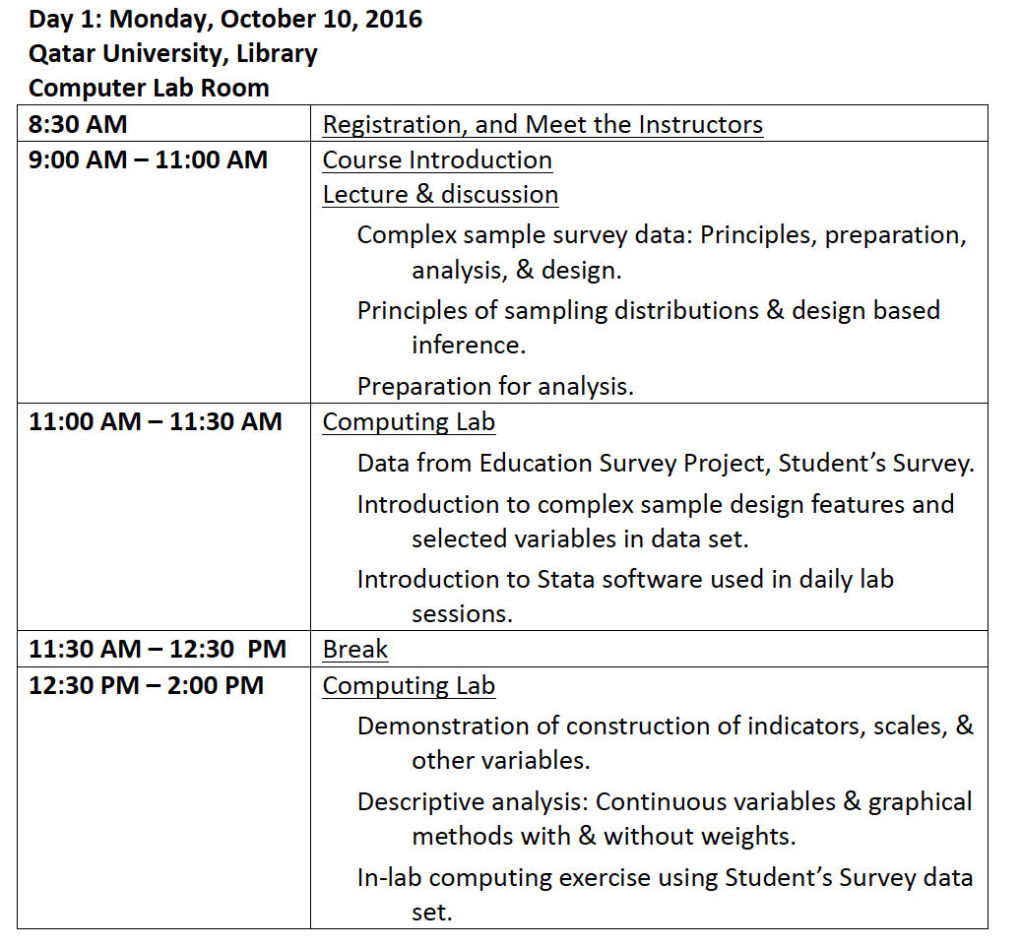
Analysis of Complex Sample Data

Slide 3
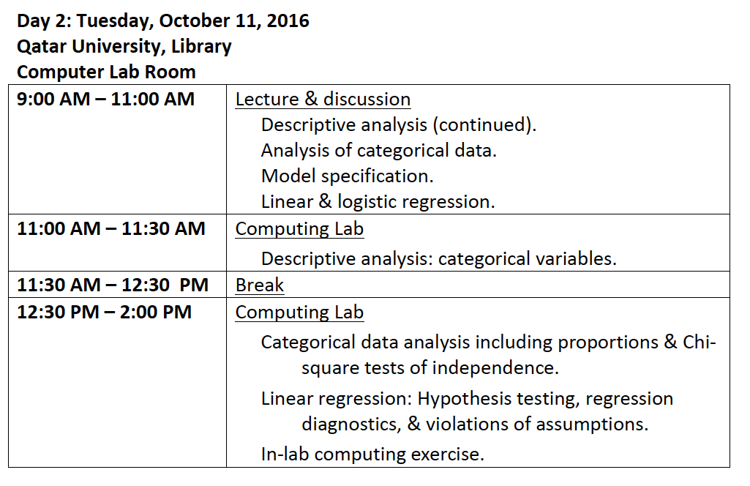
Analysis of Complex Sample Data

Slide 4
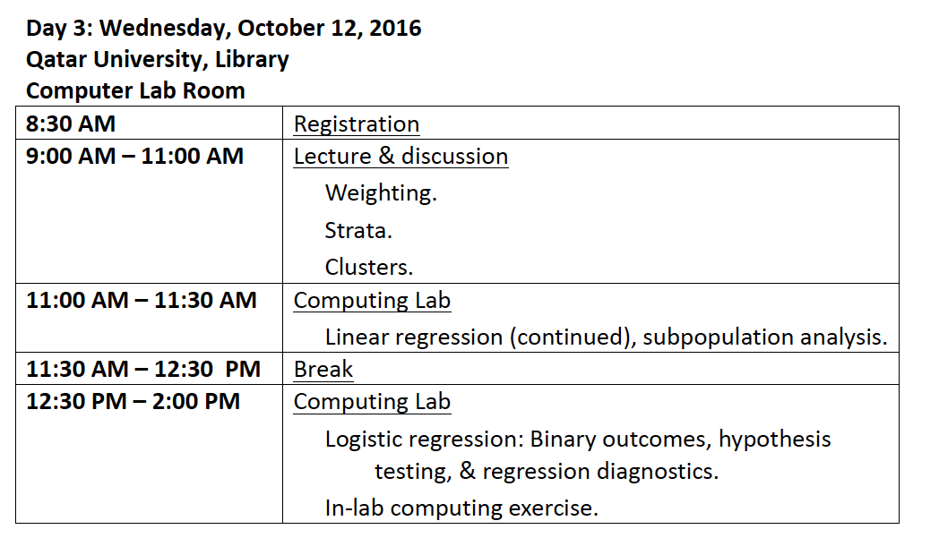
Analysis of Complex Sample Data

Slide 5
Analysis of Complex Sample Data

Slide 6
Computing Lab Sessions
This presentation includes lecture slides for the four computing lab sessions, October 10-13, 2016
Computing lab slides present Stata code and results along with explanation, we will work through the materials together in the lab sessions and discuss code/results together
We will also provide a Stata “.do” file for you to use as a starting point for our labs along with Stata format data sets
Each computing lab will include in-lab exercises done under supervision of the instructors, use the .do file provided to complete the exercises
Our goal is not to teach you how to use Stata but rather to provide enough background to analyze complex sample survey data correctly using Stata and help you generalize to your software of choice: SPSS, SAS, R, IVEware, Mplus, Wesvar, etc.

Slide 7
Computer Lab #1, October 10, 2016 Introduction to Stata and Student’s Survey Data Set
In our first computing lab, we focus on becoming familiar with Stata software and key variables of the Qatar Education Survey, Student’s Survey data set
This data set is based upon a complex sample design including stratification, clustering and a weight
We will use an example data set to learn how to correctly analyze complex sample survey data
Stata is our choice of software for our sessions together though many other good options are available:
SPSS Complex Samples module, SAS SURVEY Procedures, R Survey Package, IVEware (University of Michigan Imputation and Variance Estimation Software), WesVar PC software, Mplus, and SUDAAN software
See the “Applied Survey Data Analysis”, Heeringa, West and Berglund (2010) textbook’s website for examples of analyses/code for each of these software tools: http://www.isr.umich.edu/src/smp/asda/

Slide 8
Introduction to Stata and Exploration of Student’s Survey Complex Sample Variables

Slide 9
Introduction to Stata Software

Slide 10
Stata Software
Stata is an excellent data management and data analysis tool
Stata can be used with either a GUI interface for point and click work or a command driven approach with “do” command files
We will use the command or “do file” method where we write/execute Stata commands and save in a “do” file as we go
This is not the only way to use Stata but this method ensures that you learn to write and save commands for future work or to replicate results
Stata has a tremendous range of survey commands (svy) and we will explore just some of the svy commands during our training this week
For more information on Stata and what it can do, see http://www.stata.com/

Slide 11
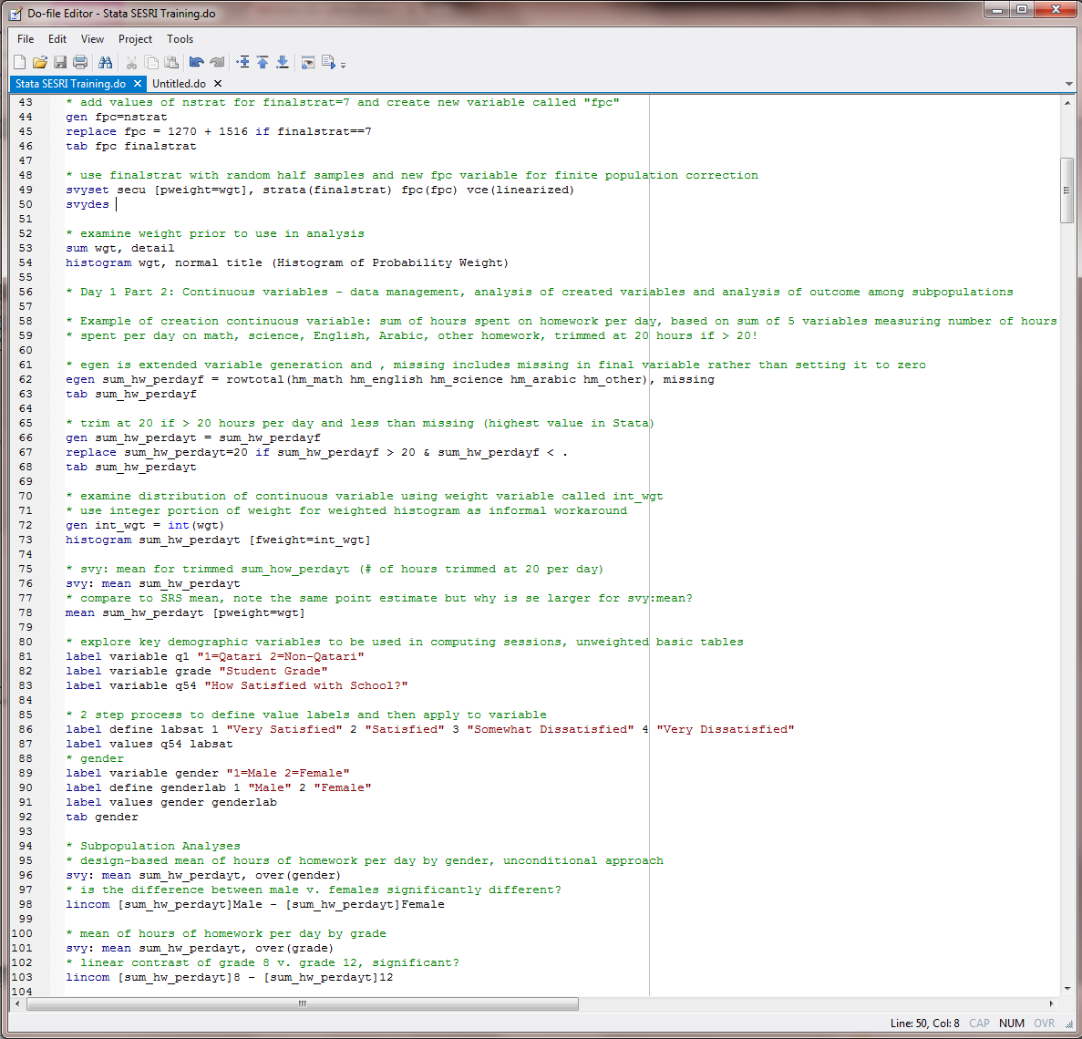
Stata Do File Editor Window
The “do” file editor is where you write and execute commands. The results of the commands will appear in the Results window (next slide).

Slide 12
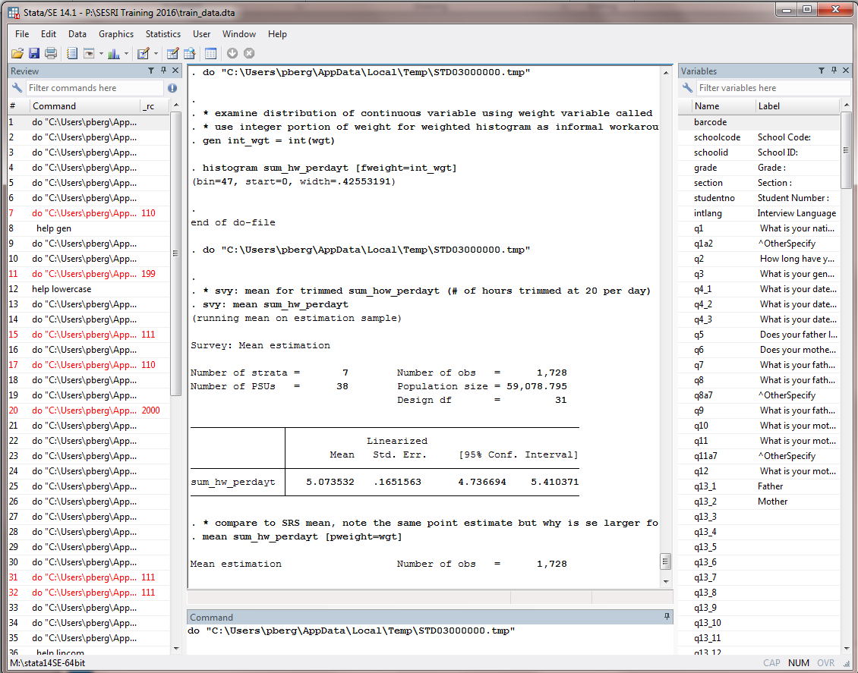
Stata Results, Command, Review, and Variables Windows
Commands executed from the Stata do file editor are echoed back in the Results window along with analysis results or error messages if your syntax has errors. The Command, Review, and Variables windows are also available if you like to have them open.

Slide 13
Demonstration: Open Data Set, Execute Stata Code, Obtain Results
After opening Stata and the do file editor and reading in commands provided, the syntax below:
“uses or opens” the data set called train_data.dta into Stata memory
Sets the “more” command off to stop having to tell Stata to scroll
Renames all variables to lower case, eliminates hassle of needing to think about case-sensitive variable names, Stata is case sensitive!
Summarizes all numeric variables in data set (more on this command to come) or describes the contents of the data set
. use "P:\SESRI Training 2016\train_data.dta", clear
. set more off
. rename *, lower
. summarize
Variable | Obs Mean Std. Dev. Min Max
-------------+---------------------------------------------------------
barcode | 0
schoolcode | 1,803 20.65613 11.83865 1 42
schoolid | 1,803 24733.56 7369.158 10028 31009
grade | 1,803 9.753744 1.569454 8 12
. describe
Contains data from P:\SESRI Training 2016\train_data.dta
obs: 1,803
vars: 229 26 AUG 2016 16:32
size: 1,374,888
----------------------------------------------------------------------------------
storage display value
variable name type format label variable label
-------------------------------_--------------------------------------------------
barcode str7 %7s
schoolcode byte %8.0g School Code:

Slide 14
Examination of Complex Sample Design Variables
As preparation for analysis of complex sample survey data, step 1 is to explore the stratification, cluster, and finite population variables along with the weight
Code below “sets up” the survey variables using the Stata “svyset” command, has entry for cluster (schoolid), pweight (wgt), strata (strat) and finite population correction (nstrat)
Variance estimation is set to default “linearized” or Taylor Series Linearization method and single clusters with stratum are set to default of missing (excluded from analysis)
Variables used are supplied by project staff
* Day 1 Part 1: Preparation for Complex Sample Survey data analysis, getting to know the survey variables, original form of design variables
. svyset schoolid [pweight=wgt], strata(strat) fpc(nstrat) vce(linearized) singleunit(missing)
. svydes
Survey: Describing stage 1 sampling units
pweight: wgt
VCE: linearized
Single unit: missing
Strata 1: strat
SU 1: schoolid
FPC 1: nstrat
#Obs per Unit
----------------------------
Stratum #Units #Obs min mean max
-------- -------- -------- -------- -------- --------
1 6 319 30 53.2 69
2 7 260 27 37.1 46
3 6 323 51 53.8 58
4 7 308 23 44.0 54
5 7 340 30 48.6 70
6 3 117 24 39.0 47
7 1* 70 70 70.0 70
8 1* 66 66 66.0 66
-------- -------- -------- -------- -------- --------
8 38 1,803 23 47.4 70
Stratum 7 and 8 have 1* in #Units colomn, meaning only one cluster (schoolid) per each stratum 7 and 8. This merits investigation due to possible problems in estimating variance.

Slide 15
Partial Output from Tabulation of School ID and Strat Variable
The tabulation (partial output) below shows the SchoolID numbers by each value of the Strat variable, note that School ID is 30347 for both Strat =7 and 8, this is an issue since we need 2 clusters per stratum for variance estimation to be robust, how to deal with this?
. tab schoolid strat
| strat
School ID: | 1 2 3 4 5 6 7 8 | Total
-----------+----------------------------------------------------------------------------------------+----------
10028 | 54 0 0 0 0 0 0 0 | 54
10509 | 69 0 0 0 0 0 0 0 | 69
10510 | 0 0 0 0 0 46 0 0 | 46
10552 | 0 0 0 0 45 0 0 0 | 45
10568 | 0 0 0 0 0 24 0 0 | 24
11044 | 0 0 0 0 30 0 0 0 | 30
20048 | 59 0 0 0 0 0 0 0 | 59
20069 | 0 0 51 0 0 0 0 0 | 51
20211 | 0 0 58 0 0 0 0 0 | 58
20290 | 50 0 0 0 0 0 0 0 | 50
20377 | 57 0 0 0 0 0 0 0 | 57
20382 | 0 0 51 0 0 0 0 0 | 51
20422 | 0 0 56 0 0 0 0 0 | 56
20423 | 0 0 52 0 0 0 0 0 | 52
21003 | 0 0 55 0 0 0 0 0 | 55
30011 | 0 0 0 0 55 0 0 0 | 55
30075 | 0 31 0 0 0 0 0 0 | 31
30090 | 0 0 0 0 0 47 0 0 | 47
30105 | 0 0 0 23 0 0 0 0 | 23
30257 | 0 0 0 33 0 0 0 0 | 33
30301 | 0 0 0 0 33 0 0 0 | 33
30331 | 0 41 0 0 0 0 0 0 | 41
30332 | 0 0 0 49 0 0 0 0 | 49
30342 | 0 39 0 0 0 0 0 0 | 39
30347 | 0 0 0 0 0 0 70 66 | 136

Slide 16
Steps to Deal with “Singleton” Cluster Stratum 7 and 8
Our method to handle the “singleton” clusters is a multi-step process
Collapse strat 7 and 8 into one stratum called “finalstrat”, sort data set by Grade variable, create an indicator of odd/even rows after sort, assign new cluster variable called “Secu” set to Schoolid for strat=1-6 and SchoolID = SchoolID +1 if finalstrat=7 and row is odd, else SchoolID =SchoolID if finalstrat=7 and row is even
* based on svydes, collapse stratum 7 and 8, see #units=1 for both of these stratum
generate finalstrat=.
replace finalstrat=strat if strat<=6
replace finalstrat=7 if strat ==7 | strat==8
tab finalstrat
* sort by grade and then do half sample secu by selecting every other row
sort grade
* create indicator of even / odd rows, if _n / 2 eq 1 (row/2 remainder not equal to 0) then odd, else even
gen odd =1 if mod(_n,2)
replace odd=0 if !mod(_n,2)
tab odd
* create a cluster variable called secu
generate secu=schoolid
replace secu=schoolid + 1 if finalstrat==7 & odd==1
replace secu=schoolid if finalstrat==7 & odd==0

Slide 17
Tabulation of Secu and Finalstrat Variables
. tab secu finalstrat
| finalstrat
secu | 1 2 3 4 5 6 7 | Total
-----------+-----------------------------------------------------------------------------+----------
10028 | 54 0 0 0 0 0 0 | 54
10509 | 69 0 0 0 0 0 0 | 69
10510 | 0 0 0 0 0 46 0 | 46
10552 | 0 0 0 0 45 0 0 | 45
10568 | 0 0 0 0 0 24 0 | 24
11044 | 0 0 0 0 30 0 0 | 30
20048 | 59 0 0 0 0 0 0 | 59
20069 | 0 0 51 0 0 0 0 | 51
20211 | 0 0 58 0 0 0 0 | 58
20290 | 50 0 0 0 0 0 0 | 50
20377 | 57 0 0 0 0 0 0 | 57
20382 | 0 0 51 0 0 0 0 | 51
20422 | 0 0 56 0 0 0 0 | 56
20423 | 0 0 52 0 0 0 0 | 52
21003 | 0 0 55 0 0 0 0 | 55
30011 | 0 0 0 0 55 0 0 | 55
30075 | 0 31 0 0 0 0 0 | 31
30090 | 0 0 0 0 0 47 0 | 47
30105 | 0 0 0 23 0 0 0 | 23
30257 | 0 0 0 33 0 0 0 | 33
30301 | 0 0 0 0 33 0 0 | 33
30331 | 0 41 0 0 0 0 0 | 41
30332 | 0 0 0 49 0 0 0 | 49
30342 | 0 39 0 0 0 0 0 | 39
30347 | 0 0 0 0 0 0 60 | 60
30348 | 0 0 0 0 0 0 76 | 76
30352 | 0 0 0 0 67 0 0 | 67
30365 | 0 0 0 0 70 0 0 | 70
30386 | 0 0 0 52 0 0 0 | 52
30423 | 0 32 0 0 0 0 0 | 32
30424 | 0 46 0 0 0 0 0 | 46
30430 | 0 0 0 0 40 0 0 | 40
30467 | 0 0 0 48 0 0 0 | 48
30654 | 0 44 0 0 0 0 0 | 44
31002 | 0 0 0 49 0 0 0 | 49
31005 | 0 27 0 0 0 0 0 | 27
31007 | 0 0 0 54 0 0 0 | 54
31009 | 30 0 0 0 0 0 0 | 30
-----------+-----------------------------------------------------------------------------+----------
Total | 319 260 323 308 340 117 136 | 1,803
Note that Finalstrat=7 now has 2 SchoolID values and a total of 136 observations in the stratum. Note 38 unique values of SECU and 7 unique values of FINALSTRAT.

Slide 18
Adjustment for Finite Population Correction
Adjustment needed since each stratum can have only one value for the FPC variable called “nstrat”
Strategy is to add the values of nstrat and use for observations where finalstrat=7, create a new variable called “fpc”, then redo svyset command with new variables:
* add values of nstrat for finalstrat=7 and generate new variable called "fpc"
gen fpc=nstrat
replace fpc = 1270 + 1516 if finalstrat==7
tab fpc finalstrat
* use finalstrat with random half samples and new fpc variable for finite population correction
svyset secu [pweight=wgt], strata(finalstrat) fpc(fpc) vce(linearized)

Slide 19
Svyset and Svydes Commands and Results
With variables adjusted, data is now ready for the svyset and svydes commands: set survey variables/weight/FPC and describe the survey setup
. svyset secu [pweight=wgt], strata(finalstrat) fpc(fpc) vce(linearized)
pweight: wgt
VCE: linearized
Single unit: missing
Strata 1: finalstrat
SU 1: secu
FPC 1: fpc
. svydes
Survey: Describing stage 1 sampling units
pweight: wgt
VCE: linearized
Single unit: missing
Strata 1: finalstrat
SU 1: secu
FPC 1: fpc
#Obs per Unit
----------------------------
Stratum #Units #Obs min mean max
-------- -------- -------- -------- -------- --------
1 6 319 30 53.2 69
2 7 260 27 37.1 46
3 6 323 51 53.8 58
4 7 308 23 44.0 54
5 7 340 30 48.6 70
6 3 117 24 39.0 47
7 2 136 60 68.0 76
-------- -------- -------- -------- -------- --------
7 38 1,803 23 47.4 76

Slide 20
Exploration of Weight Variable
* examine weight prior to use in analysis
. sum wgt, detail
wgt
-------------------------------------------------------------
Percentiles Smallest
1% 16.75312 16.75312
5% 19.70071 16.75312
10% 23.08841 16.75312 Obs 1,803
25% 27.29081 16.75312 Sum of Wgt. 1,803
50% 30.51513 Mean 34.38912
Largest Std. Dev. 10.72349
75% 39.6687 61.55546
90% 51.53344 61.55546 Variance 114.9933
95% 54.69457 61.55546 Skewness .7266384
99% 61.55546 61.55546 Kurtosis 2.749682
. total wgt
Total estimation Number of obs = 1,803
--------------------------------------------------------------
| Total Std. Err. [95% Conf. Interval]
-------------+------------------------------------------------
wgt | 62003.59 455.3383 61110.54 62896.64
. histogram wgt, normal title (Histogram of Probability Weight)

Slide 21
Variable Construction: Sum of Hours of Homework Per Day Spent on Math, English, Science, Arabic, Other Homework
egen is extended variable generation, produces a row total of the variables in the parentheses with , missing option: includes missing in final variable rather than setting it to zero
. egen sum_hw_perdayf = rowtotal(hm_math hm_english hm_science hm_arabic hm_other), missing (75 missing values generated)
. tab sum_hw_perdayf
sum_hw_perd |
ayf | Freq. Percent Cum.
------------+-----------------------------------
0 | 35 2.03 2.03
.5 | 9 0.52 2.55
...
20 | 4 0.23 98.21
21 | 3 0.17 98.38
21.5 | 1 0.06 98.44
22.5 | 1 0.06 98.50
23 | 1 0.06 98.55
24 | 2 0.12 98.67
25 | 6 0.35 99.02
26 | 1 0.06 99.07
29 | 1 0.06 99.13
31 | 1 0.06 99.19
33 | 2 0.12 99.31
34 | 1 0.06 99.36
35 | 1 0.06 99.42
40 | 1 0.06 99.48
41 | 1 0.06 99.54
50 | 8 0.46 100.00
------------+-----------------------------------
Total | 1,728 100.00
Values > 20 are unrealistic, will be trimmed to 20 in next step.

Slide 22
Trimming Homework Per Day Variable
* trim at 20 if > 20 hours per day and less than missing (highest value in Stata)
. gen sum_hw_perdayt = sum_hw_perdayf
. replace sum_hw_perdayt=20 if sum_hw_perdayf > 20 & sum_hw_perdayf < .
* check results of trimming
. tab sum_hw_perdayt
sum_hw_perd |
ayt | Freq. Percent Cum.
------------+-----------------------------------
0 | 35 2.03 2.03
.5 | 9 0.52 2.55
......
......
......
18.5 | 1 0.06 97.74
19 | 4 0.23 97.97
20 | 35 2.03 100.00

Slide 23
Weighted Histogram of Trimmed Sum of Hours Spent on Homework Per Day
Examine distribution of continuous variable using weight variable called int_wgt
Use integer portion of weight for weighted histogram as informal workaround, OK for a rough idea of distribution but not for final analysis!
. gen int_wgt = int(wgt)
. histogram sum_hw_perdayt [fweight=int_wgt]

Slide 24
Descriptive Analysis of Continuous Variables

Slide 25
Preparation for Analysis of Survey Data
More on preparation to analyze data by creating variables, attaching labels, exploring raw distributions, with intended analysis in mind
Stata code showing how to use labels for existing or generated variables/values:
* explore key demographic variables to be used in computing sessions, unweighted basic tables
label variable q1 "1=Qatari 2=Non-Qatari"
label variable grade "Student Grade"
label variable q54 "How Satisfied with School?"
* 2 step process to define value labels and then apply to variable
label define labsat1 1 "Very_Satisfied" 2 "Satisfied" 3 "Somewhat_Dissatisfied" 4 "Very_Dissatisfied"
label values q54 labsat1
* gender
label variable gender "1=Male 2=Female"
label define genderlab 1 "Male" 2 "Female"
label values gender genderlab
tab
. tab gender
1=Male |
2=Female | Freq. Percent Cum.
------------+-----------------------------------
Male | 857 47.77 47.77
Female | 937 52.23 100.00
------------+-----------------------------------
Total | 1,794 100.00

Slide 26
Hours Spent on Homework Per Day, Comparison of Design-Based and SRS Estimates
This analysis compares mean hours spent on homework per day (trimmed version) using the svy:mean and mean commands, note that mean estimate is the same for both analyses but standard errors differ, this is expected expected due to incorporation of design features
. * svy: mean for trimmed sum_how_perdayt (# of hours trimmed at 20 per day)
. svy: mean sum_hw_perdayt
(running mean on estimation sample)
Survey: Mean estimation
Number of strata = 7 Number of obs = 1,728
Number of PSUs = 38 Population size = 59,078.795
Design df = 31
----------------------------------------------------------------
| Linearized
| Mean Std. Err. [95% Conf. Interval]
---------------+------------------------------------------------
sum_hw_perdayt | 5.073532 .1644902 4.738052 5.409012
----------------------------------------------------------------
. * compare to SRS mean, note the same point estimate but why is se larger for svy:mean?
. mean sum_hw_perdayt [pweight=wgt]
Mean estimation Number of obs = 1,728
----------------------------------------------------------------
| Mean Std. Err. [95% Conf. Interval]
---------------+------------------------------------------------
sum_hw_perdayt | 5.073532 .0991164 4.879132 5.267933
----------------------------------------------------------------

Slide 27
Subpopulation Analysis and Linear Contrast Hours Spent Per Day on Homework by Gender
Let’s say we want to estimate mean hours spent on homework per day by gender
For this, a subpopulation analysis is done with either the over() or subpop statement, this is an unconditional rather than conditional approach (correct approach is unconditional!)
This example shows use of over(gender) plus the lincom command for contrast of mean males-female, design-based linear contrast
. * Subpopulation Analyses
. * design-based mean of hours of homework per day by gender, unconditional approach
. svy: mean sum_hw_perdayt, over(gender)
(running mean on estimation sample)
Survey: Mean estimation
Number of strata = 7 Number of obs = 1,719
Number of PSUs = 38 Population size = 58,820.239
Design df = 31
Male: gender = Male
Female: gender = Female
----------------------------------------------------------------
| Linearized
Over | Mean Std. Err. [95% Conf. Interval]
---------------+------------------------------------------------
sum_hw_perdayt |
Male | 5.012752 .2311926 4.541232 5.484273
Female | 5.133992 .192435 4.741518 5.526465
----------------------------------------------------------------
. * is the difference between male v. females significantly different?
. lincom [sum_hw_perdayt]Male - [sum_hw_perdayt]Female
( 1) [sum_hw_perdayt]Male - [sum_hw_perdayt]Female = 0
------------------------------------------------------------------------------
Mean | Coef. Std. Err. t P>|t| [95% Conf. Interval]
-------------+----------------------------------------------------------------
(1) | -.1212397 .2657003 -0.46 0.651 -.663139 .4206596
------------------------------------------------------------------------------

Slide 28
Subpopulation Analysis and Linear Contrast for Hours Spent on Homework Per Day, by Grade Level
Analysis similar to previous slide but mean hours spent on homework by grade plus linear contrast of grade 8 – grade12
. * mean of hours of homework per day by grade
. svy: mean sum_hw_perdayt, over(grade)
(running mean on estimation sample)
Survey: Mean estimation
Number of strata = 7 Number of obs = 1,728
Number of PSUs = 38 Population size = 59,078.795
Design df = 31
8: grade = 8
9: grade = 9
11: grade = 11
12: grade = 12
----------------------------------------------------------------
| Linearized
Over | Mean Std. Err. [95% Conf. Interval]
---------------+------------------------------------------------
sum_hw_perdayt |
8 | 4.381748 .2112874 3.950825 4.812672
9 | 4.929205 .2210625 4.478345 5.380065
11 | 5.616167 .4094865 4.781014 6.451321
12 | 5.658863 .3670656 4.910228 6.407498
----------------------------------------------------------------
. * linear contrast of grade 8 v. grade 12, significant?
. lincom [sum_hw_perdayt]8 - [sum_hw_perdayt]12
( 1) [sum_hw_perdayt]8 - [sum_hw_perdayt]12 = 0
------------------------------------------------------------------------------
Mean | Coef. Std. Err. t P>|t| [95% Conf. Interval]
-------------+----------------------------------------------------------------
(1) | -1.277114 .4233318 -3.02 0.005 -2.140505 -.4137235
------------------------------------------------------------------------------
Test of 4.381-5.658, is this significant at alpha = 0.05 level with design-based estimation?
Yes, p value of 0.005 is < 0.05.

Slide 29
Day 1 - Computing Lab Exercises
The exercises are designed to help you learn to use Stata to do survey data analysis. Today’s exercises focus on getting to know the survey design variables and also performing descriptive analysis of continuous variables. For our first set of exercises, we will work on the exercises together as a group.
---------------------------------------------------------------------------------------------------------------------------------
Day 1 Exercises
Open Stata and open the pre-programmed syntax file called Lab 1_4 Exercises Final.do in the Stata do file editor. Locate the Student’s survey data set Day1_final.dta on your network or local drive, read the data into memory and obtain a listing of variables in the data set. Note that the variables created in the demonstration today, finalstrat, secu, wgt, hm_math, are already created for you and ready to use.
Generate a one way table of the complex sample design variable finalstrat and another one way table of the variable secu. What do these variables represent?
Do a descriptive analysis of the weight variable called wgt. Based on the results, what is the mean of this variable? What is the sum of the weight variable and what does this represent?
Set up the survey variables (finalstrat and secu), finite population correction (fpc) and weight (wgt) using the svyset command and then use svydes to obtain a descriptive table of the key variables.
Perform a design-based analysis to obtain the estimated mean of number of hours spent on math homework per day (hm_math). What is the overall mean and the design-adjusted SE? How much missing data does the variable have?

Slide 30
Computing Lab #2, October 11, 2016
Our second computing lab focuses on descriptive analysis of categorical data using weighted bar charts with tabulate and graph commands, and proportions and tabulations with svy: proportion and svy: tab commands
Output statistics: proportions, percentages, chisq tests, contrasts
We also cover linear and logistic regression model specification followed by linear regression examples:
Output statistics: hypothesis tests, regression diagnostics, checks for violations of assumptions
Computer lab exercises will build on our work yesterday and also give you a chance to focus on today’s topics, open the

Slide 31
Descriptive Analysis of Categorical Variables

Slide 32
Bar Chart (Weighted) of Q54: How Satisfied with School?
* weighted bar chart to examine distribution of q54, create categories of q54 to use in bar chart
. tabulate q54, generate(q54)
* Labels
. label var q541 "VS"
. label var q542 "S"
. label var q543 "SD"
. label var q544 "VD“
*Graph bar chart command, one long command, use /// to show continuation
graph bar (mean) q541 q542 q543 q544 [pweight=wgt] , percentages ///
bar(1,color(gs12)) bar(2,color(gs4)) bar(3,color(gs8)) bar(4,color(gs7)) ///
blabel(bar, format(%5.1f)) bargap(7) scheme(s2mono) ///
legend (label(1 "VS")label(2 "S") label(3 "SD") label(4 "VD")) ytitle ("Percentage")
Important to use weight in graph to obtain unbiased percentages.

Slide 33
Svy: Proportion for Analysis of Categorical Variable Q54: How Satisfied with School?
We will use svy: proportion and svy: tabulate to perform descriptive analysis of categorical variables
These commands will produce the same results but are alternative ways to examine categorical variables
* proportions and se for q54 How Satisfied with School? use of svy: proportion
. svy: proportion q54
(running proportion on estimation sample)
Survey: Proportion estimation
Number of strata = 7 Number of obs = 1,595
Number of PSUs = 38 Population size = 54,547.638
Design df = 31
-----------------------------------------------------------------------
| Linearized
| Proportion Std. Err. [95% Conf. Interval]
----------------------+------------------------------------------------
q54 |
Very_Satisfied | .3307653 .020928 .2895547 .3747474
Satisfied | .4753869 .0171569 .4405725 .5104422
Somewhat_Dissatisfied | .1217597 .0121356 .0990943 .1487532
Very_Dissatisfied | .0720881 .009615 .054774 .094329
-----------------------------------------------------------------------
. lincom [q54]Very_Satisfied - [q54]Satisfied
( 1) [q54]Very_Satisfied - [q54]Satisfied = 0
------------------------------------------------------------------------------
Proportion | Coef. Std. Err. t P>|t| [95% Conf. Interval]
-------------+----------------------------------------------------------------
(1) | -.1446216 .0332358 -4.35 0.000 -.2124065 -.0768367
------------------------------------------------------------------------------

Slide 34
Svy: Tabulate with Linear Contrast (lincom) for Analysis of Categorical Variable Q54, “How Satisfied with School?”
Use of svy: tab for tabulation of same variable with SE, cell proportions and CI
Lincom for contrast of Very Satisfied – Satisfied
. svy: tab q54, se cell ci
(running tabulate on estimation sample)
Number of strata = 7 Number of obs = 1,595
Number of PSUs = 38 Population size = 54,547.638
Design df = 31
----------------------------------------------------------
How |
Satisfied |
with |
School? | proportion se lb ub
----------+-----------------------------------------------
Very_Sat | .3308 .0209 .2896 .3747
Satisfie | .4754 .0172 .4406 .5104
Somewhat | .1218 .0121 .0991 .1488
Very_Dis | .0721 .0096 .0548 .0943
|
Total | 1
----------------------------------------------------------
Key: proportion = cell proportion
se = linearized standard error of cell proportion
lb = lower 95% confidence bound for cell proportion
ub = upper 95% confidence bound for cell proportion
] . lincom _b[p1]-_b[p2
( 1) p11 - p21 = 0
------------------------------------------------------------------------------
Mean | Coef. Std. Err. t P>|t| [95% Conf. Interval]
-------------+----------------------------------------------------------------
(1) | -.1446216 .0332358 -4.35 0.000 -.2124065 -.0768367
------------------------------------------------------------------------------
Use p11 – p21 in lincom to refer to proportions from table, _b refers to “beta” value stored internally.

Slide 35
Two-Way Table Analysis
Here, a two-way crosstabulation is performed using svy: tab with two variables: a “factor” variable of gender and an indicator of spending >=8 hours on math homework per day
The analysis goal is to explore if there is a significant association between these two variables using ChiSquare and F tests (design-based):
. * generate a variable that is coded 1 if hour of homework per day >= 8 and 0 otherwise
. gen hm8p=0
. replace hm8p =1 if sum_hw_perdayt >=8
(354 real changes made)
. tab hm8p
hm8p | Freq. Percent Cum.
------------+-----------------------------------
0 | 1,449 80.37 80.37
1 | 354 19.63 100.00
------------+-----------------------------------
Total | 1,803 100.00
. * perform svy: tab of hm8p * gender, is the null hypothesis of no association rejected?
. svy: tab gender hm8p, row se
(running tabulate on estimation sample)
Number of strata = 7 Number of obs = 1,794
Number of PSUs = 38 Population size = 61,745.033
Design df = 31
-------------------------------------
1=Male | hm8p
2=Female | 0 1 Total
----------+--------------------------
Male | .7722 .2278 1
| (.0185) (.0185)
|
Female | .8155 .1845 1
| (.0219) (.0219)
|
Total | .7936 .2064 1
| (.0163) (.0163)
-------------------------------------
Key: row proportion
(linearized standard error of row proportion)
Pearson:
Uncorrected chi2(1) = 5.1292
Design-based F(1, 31) = 2.9944 P = 0.0935
The design-based F test has (1,31) dfs and is equal to 2.99 with a p value=0.0935, a non-significant result at alpha=0.05. In this case we fail to reject the null hypothesis of no association.

Slide 36
Linear Regression

Slide 37
Linear Regression Stata Code
Data management plus model building using a general process:
plots to evaluate variable distributions (histograms)
bivariate tests of simple regression model, done one predictor at a time
preliminary model fitting and evaluation, what variables should remain in “final” model?
final model fit and evaluation, (use of log of dependent variable to address non-normal dependent variable distribution)
regression diagnostic tools such as histograms of residuals and qnorm plot of residuals
* linear regression : number of hours spent on homework predicted by nationality and parents education
label variable q1 "1=Qatari 2=Non-Qatari"
label var heldback "1=Yes 0=No"
* examine distributions for model variables
tab1 q1 grade heldback
histogram sum_hw_perdayt, normal
gen loghomework = log(sum_hw_perdayt)
histogram loghomework, normal
* yes or no to q22 how often parents check on if homework done?
gen par_check_hmwk =0
replace par_check_hmwk=1 if q22 >=2 & q22 < .
tab par_check_hmwk
* bivariate regression for model building
svy: reg loghomework i.q1
svy: reg loghomework i.grade
svy: reg loghomework i.heldback
svy: reg loghomework i.gender
svy: reg loghomework i.par_check_hmwk
* each predictor above has F test for bivariate model : p < 0.25
svy: reg loghomework i.q1 i.grade i.gender i.heldback i.par_check_hmwk
* test each group of predictors contribution to model above
test 2.q1
test 9.grade 11.grade 12.grade
test 1.heldback
* all tests are significant at 0.05 level except for gender and heldback, remove from model
* Reminde: this is a model where (log Y= linear in x)
svy: reg loghomework i.q1 i.grade i.par_check_hmwk
* model diagnostics : residual analysis
predict ehat3, resid
* histogram of residuals
histogram ehat3, normal title (Log of Hours Homework Per Day) name(histogram_ehat)
* qnorm plot
qnorm ehat3, title (qnorm of Ehat3) name(ehat3)
* how to interpret log(Y) = linear (X)? What if we want to know what happens to the outcome variable y itself for a one-unit increase in x1?
* The natural way to do this is to interpret the exponentiated regression coefficients, exp(β), since exponentiation is the inverse of logarithm function.
* Stata can do this for you by adding the eform (exp(Coef.)) option
svy: reg loghomework i.q1 i.grade i.par_check_hmwk, eform(exp(Coef.))

Slide 38
Linear Regression, Check Distribution of Dependent Variable
Examine distributions of original scale and log scale for dependent variable, hours spent per day on homework
Log transformed dependent variable is used in models, use of log transformation improves distribution, closer to normal distribution
. histogram sum_hw_perdayt, normal
. gen loghomework = log(sum_hw_perdayt)
. histogram loghomework, normal

Slide 39
Model Evaluation/Building for “Preliminary” Model
* each predictor above has F test for bivariate model : p < 0.25
. svy: reg loghomework i.q1 i.grade i.gender i.heldback i.par_check_hmwk
(running regress on estimation sample)
Survey: Linear regression
Number of strata = 7 Number of obs = 1,602
Number of PSUs = 38 Population size = 54,716.112
Design df = 31
F( 7, 25) = 2.97
Prob > F = 0.0209
R-squared = 0.0395
----------------------------------------------------------------------------------
| Linearized
loghomework | Coef. Std. Err. t P>|t| [95% Conf. Interval]
-----------------+----------------------------------------------------------------
2.q1 | .1235796 .0460728 2.68 0.012 .0296135 .2175457
|
grade |
9 | .0795013 .0501483 1.59 0.123 -.0227768 .1817794
11 | .2139155 .0710805 3.01 0.005 .0689459 .3588851
12 | .2508334 .0668851 3.75 0.001 .1144203 .3872464
|
gender |
Female | .0564666 .0412127 1.37 0.180 -.0275873 .1405205
1.heldback | -.0941122 .0850131 -1.11 0.277 -.2674975 .0792731
1.par_check_hmwk | .0913534 .0409918 2.23 0.033 .00775 .1749568
_cons | 1.148032 .0656616 17.48 0.000 1.014114 1.28195
----------------------------------------------------------------------------------
. * test each group of predictors contribution to model above
. test 2.q1
Adjusted Wald test
( 1) 2.q1 = 0
F( 1, 31) = 7.19
Prob > F = 0.0116
. test 9.grade 11.grade 12.grade
Adjusted Wald test
( 1) 9.grade = 0
( 2) 11.grade = 0
( 3) 12.grade = 0
F( 3, 29) = 4.90
Prob > F = 0.0071
. test 1.heldback
Adjusted Wald test
( 1) 1.heldback = 0
F( 1, 31) = 1.23
Prob > F = 0.2768
After bivariate tests for each predictor, with log of dependent variable, use nationality, grade, gender, held back a grade and parents check homework 1+ times per week in “preliminary” model. Use test statements to obtain F tests for each predictor in model. Since gender and held back are not significant at the p < 0.05 level, remove from model.

Slide 40
Final Model, Estimation and Diagnostics
* all tests are significant at 0.05 level except for gender and heldback, remove from model
. * Log - linear model (log Y= linear x)
. svy: reg loghomework i.q1 i.grade i.par_check_hmwk
(running regress on estimation sample)
Survey: Linear regression
Number of strata = 7 Number of obs = 1,655
Number of PSUs = 38 Population size = 56,525.204
Design df = 31
F( 5, 27) = 4.78
Prob > F = 0.0029
R-squared = 0.0353
----------------------------------------------------------------------------------
| Linearized
loghomework | Coef. Std. Err. t P>|t| [95% Conf. Interval]
-----------------+----------------------------------------------------------------
2.q1 | .1278829 .0486643 2.63 0.013 .0286314 .2271344
|
grade |
9 | .0915734 .0526173 1.74 0.092 -.0157403 .1988871
11 | .2195736 .0721492 3.04 0.005 .0724243 .366723
12 | .2527043 .0677689 3.73 0.001 .1144887 .3909199
|
1.par_check_hmwk | .0872448 .0377432 2.31 0.028 .0102671 .1642226
_cons | 1.163203 .0564876 20.59 0.000 1.047996 1.27841
----------------------------------------------------------------------------------
Our “final” model requires evaluation/diagnostics post-estimation. At this point, the predictors appear sensible though the Rsquared is quite low, 0.0353, suggests perhaps additional predictors could be tested for inclusion in model. Ok for demonstration purposes.

Slide 41
Plots to Evaluate Model Fit for Final Model
* model diagnostics
* residual analysis
. predict ehat3, resid
* histogram of residuals
. histogram ehat3, normal title (Log of Hours Homework Per Day Final) name(histogram_ehat_Final)
* qnorm plot
. qnorm ehat3, title (Qnorm of Ehat3) name(ehat3_Final)
Plots indicate relatively normal distribution of residuals and also normal normal Qnorm plot.

Slide 42
Exponentiated Coefficients for Final Model
. * how to interpret log(Y) = linear (X)?
. * what if we want to know what happens to the outcome variable y itself for a one-unit increase in x1?
. * The natural way to do this is to interpret the exponentiated regression coefficients, exp(β), since exponentiation is the inverse of logarithm function.
. * Stata can do this for you by adding the eform (exp(Coef.)) option
. svy: reg loghomework i.q1 i.grade i.par_check_hmwk, eform(exp(Coef.))
(running regress on estimation sample)
Survey: Linear regression
Number of strata = 7 Number of obs = 1,655
Number of PSUs = 38 Population size = 56,525.204
Design df = 31
F( 5, 27) = 4.78
Prob > F = 0.0029
R-squared = 0.0353
----------------------------------------------------------------------------------
| Linearized
loghomework | exp(Coef.) Std. Err. t P>|t| [95% Conf. Interval]
-----------------+----------------------------------------------------------------
2.q1 | 1.13642 .0553031 2.63 0.013 1.029045 1.254999
|
grade |
9 | 1.095897 .0576632 1.74 0.092 .9843829 1.220044
11 | 1.245546 .0898652 3.04 0.005 1.075111 1.442998
12 | 1.287503 .0872526 3.73 0.001 1.1213 1.47834
|
1.par_check_hmwk | 1.091164 .041184 2.31 0.028 1.01032 1.178477
_cons | 3.200168 .1807697 20.59 0.000 2.85193 3.590927
----------------------------------------------------------------------------------

Slide 43
Day 2 - Computing Lab Exercises
Open the Lab 1_4 Exercises Final.do file and the Day2_final.dta data set and use the des command to obtain information about the data set’s variables. Locate the variables used in the questions below: gender, heldback, fathersed, loghomework. Note that these variables are constructed for you but you would need to do this yourself in the “real world”.
Run a 2 way cross-tabulation using svy: tab with gender (gender) and if held back a grade (heldback). Request row proportions. Fill in the red question marks in the table:
Number of strata = 7 Number of obs = 1,733
Number of PSUs = 38 Population size = 59,554.192
Design df = 31
-------------------------------------
1=Male | 1=Yes 0=No
2=Female | 0 1 Total
----------+--------------------------
Male | ? ?
| (.0236) (.0236)
|
Female | ? ?
| (.0215) (.0215)
|
Total | .9026 .0974 1
| (.0162) (.0162)
-------------------------------------
Key: row proportion
(linearized standard error of row proportion)
Pearson:
Uncorrected chi2(1) = 3.0394
Design-based F(1, 31) = ? P =?
Is there a significant association between gender and being held back a grade? Provide the F value (df) and p value to support your decision.
Run this linear regression model using svy: regress:
loghomework = fathered (coded 1=less than Bachelors degree and 2=Bachelors and higher) Gender
Make sure to use factor coding for the predictors and request the eform or exponentiated coefficients for the model results.
Fill in the table question marks with results from your regression. Interpret the results in the filled in table. How does being female and father education predict the log of hours spent on home work per day?
------------------------------------------------------------------------------
| Linearized
loghomework | exp(Coef.) Std. Err. t P>|t| [95% Conf. Interval]
-------------+----------------------------------------------------------------
2.fathered | 1.089918 ? 1.69 0.102 .9821704 1.209486
|
gender |
Female | 1.054397 .0444178 ? 0.218 .9675887 1.148993
_cons | ? .1852414 28.94 0.000 3.562085 4.318859
------------------------------------------------------------------------------

Slide 44
Computing Lab #3, October 12, 2016
Topics for Computing Lab #3 include:
Continuation of linear regression with subpopulation analysis
Logistic regression with a binary outcome, hypothesis testing and logistic regression diagnostics
In-lab computing exercise focuses on logistic regression

Slide 45
Linear Regression with Subpopulation Indicator
gen g12=0
. replace g12=1 if grade != 12
(1,417 real changes made)
. tab g12
g12 | Freq. Percent Cum.
------------+-----------------------------------
0 | 386 21.41 21.41
1 | 1,417 78.59 100.00
------------+-----------------------------------
Total | 1,803 100.00
. svy,subpop (g12): reg loghomework i.q1 i.par_check_hmwk, eform(exp(Coef.))
(running regress on estimation sample)
Survey: Linear regression
Number of strata = 7 Number of obs = 1,694
Number of PSUs = 38 Population size = 58,052.455
Subpop. no. obs = 1,308
Subpop. size = 44,111.793
Design df = 31
F( 2, 30) = 4.83
Prob > F = 0.0152
R-squared = 0.0138
----------------------------------------------------------------------------------
| Linearized
loghomework | exp(Coef.) Std. Err. t P>|t| [95% Conf. Interval]
-----------------+----------------------------------------------------------------
2.q1 | 1.117044 .0594377 2.08 0.046 1.002166 1.24509
1.par_check_hmwk | 1.139346 .0558406 2.66 0.012 1.030966 1.259121
_cons | 3.424982 .1779843 23.69 0.000 3.080555 3.807918
----------------------------------------------------------------------------------
Generate an indicator of being in the subpopulation of interest: grade 12. g12 =1 if in grade 12, 0 otherwise. This assumes any missing data set to 0!
Note that the subpopulation indicator is inserted into the svy, subpop (g12) code, tells Stata to process all records but analyze only those in subpopulation (1,308 obs.)

Slide 46
Logistic Regression

Slide 47
Model Building for Logistic Regression
Model building/testing uses similar approach to linear regression presented in previous section
This example will skip some steps to keep presentation brief but refer to the lecture notes and linear regression lab materials for a review
This demonstration presents use of logistic regression for a binary outcome variable (yes/no) but many extensions are available for survey data analysis in Stata and other software tools (ordinal, multinomial outcomes, etc.)

Slide 48
Variable Generation Prior to Logistic Regression Analysis
Prior to use of logistic regression, create an indicator of answering “very likely” to q49:
“How likely is that you would go to college education after you leave secondary/high school”?
. tab q49
How likely |
is that you |
would go to |
college |
education |
after you |
leave |
secondary/ | Freq. Percent Cum.
------------+-----------------------------------
-8 | 101 5.73 5.73
1 | 1,272 72.11 77.83
2 | 334 18.93 96.77
3 | 42 2.38 99.15
4 | 15 0.85 100.00
------------+-----------------------------------
Total | 1,764 100.00
. gen college=.
(1,803 missing values generated)
. replace college=1 if q49==1
(1,272 real changes made)
. replace college=0 if q49 >=2 & q49 <=4
(391 real changes made)
. tab college q49
| How likely is that you would go to college
| education after you leave secondary/
college | 1 2 3 4 | Total
-----------+--------------------------------------------+----------
0 | 0 334 42 15 | 391
1 | 1,272 0 0 0 | 1,272
-----------+--------------------------------------------+----------
Total | 1,272 334 42 15 | 1,663
Note that -8 is set to missing along with other missing data cases. You could use other strategies as well.

Slide 49
Relationship Between Cross-Tabulation and Bivariate Logistic Regression
. svy: tab college gender
(running tabulate on estimation sample)
Number of strata = 7 Number of obs = 1,654
Number of PSUs = 38 Population size = 56,538.666
Design df = 31
----------------------------------
| 1=Male 2=Female
college | Male Female Total
----------+-----------------------
0 | .1369 .1051 .242
1 | .3582 .3998 .758
|
Total | .495 .505 1
----------------------------------
Key: cell proportion
Pearson:
Uncorrected chi2(1) = 10.5109
Design-based F(1, 31) = 3.5780 P = 0.0679
. svy: logistic college i.gender
(running logistic on estimation sample)
Survey: Logistic regression
Number of strata = 7 Number of obs = 1,654
Number of PSUs = 38 Population size = 56,538.666
Design df = 31
F( 1, 31) = 3.56
Prob > F = 0.0686
------------------------------------------------------------------------------
| Linearized
college | Odds Ratio Std. Err. t P>|t| [95% Conf. Interval]
-------------+----------------------------------------------------------------
gender |
Female | 1.453354 .2880164 1.89 0.069 .9701511 2.177226
_cons | 2.617038 .3678754 6.84 0.000 1.964721 3.485935
------------------------------------------------------------------------------
Start with svy: tab to examine relationship between gender and how likely to go to college.
Repeat analysis using college as outcome and predicted by gender using svy: logistic command. Gives same result, gender is a important and nearly significant (alpha=0.05 level) predictor of being likely to go to college.

Slide 50
Expanded Logistic Model: Gender, Grade and Nationality as Predictors
. svy: logistic college i.gender ib12.grade i.q1
(running logistic on estimation sample)
Survey: Logistic regression
Number of strata = 7 Number of obs = 1,622
Number of PSUs = 38 Population size = 55,436.974
Design df = 31
F( 5, 27) = 5.08
Prob > F = 0.0021
------------------------------------------------------------------------------
| Linearized
college | Odds Ratio Std. Err. t P>|t| [95% Conf. Interval]
-------------+----------------------------------------------------------------
gender |
Female | 1.488308 .2619322 2.26 0.031 1.039458 2.130977
|
grade |
8 | 1.049272 .2363652 0.21 0.832 .6627637 1.661182
9 | .936121 .2104259 -0.29 0.771 .5918734 1.480591
11 | 1.24599 .2592139 1.06 0.299 .8151629 1.904515
|
2.q1 | 1.661799 .2581281 3.27 0.003 1.210583 2.281195
_cons | 1.8705 .4197286 2.79 0.009 1.183589 2.956068
------------------------------------------------------------------------------
. * test if grade is significant in contribution to model
. test 8.grade 9.grade 11.grade
Adjusted Wald test
( 1) [college]8.grade = 0
( 2) [college]9.grade = 0
( 3) [college]11.grade = 0
F( 3, 29) = 0.60
Prob > F = 0.6219
Use of ib12.grade allows us to use grade 12 as reference group for grade variable. Default is lowest value, grade 8.
The 3 levels of Grade are not significantly different from zero contribution to model, drop from model and re-test.

Slide 51
“Final” Reduced Model Excluding Grade
. svy: logistic college i.gender i.q1
(running logistic on estimation sample)
Survey: Logistic regression
Number of strata = 7 Number of obs = 1,622
Number of PSUs = 38 Population size = 55,436.974
Design df = 31
F( 2, 30) = 7.33
Prob > F = 0.0026
------------------------------------------------------------------------------
| Linearized
college | Odds Ratio Std. Err. t P>|t| [95% Conf. Interval]
-------------+----------------------------------------------------------------
gender |
Female | 1.471561 .2643247 2.15 0.039 1.020184 2.12265
2.q1 | 1.661668 .2512454 3.36 0.002 1.220727 2.261884
_cons | 1.95638 .3353781 3.91 0.000 1.379149 2.775207
------------------------------------------------------------------------------

Slide 52
Logistic Regression Post-Estimation Tools
Regression diagnostics for svy: logistic are not extensive (area of ongoing interest/work!) but in Stata, can request estat effects and estat gof (post-estimation design effects and goodness of fit for regression)
Design effects are influenced by FPC, more on this topic in 4th lecture/lab
* regression diagnostics for svy: logistic are not fully developed but show use of estat effects and estat gof
. estat gof
Logistic model for college, goodness-of-fit test
F(9,23) = 0.69
Prob > F = 0.7101
. estat effects
----------------------------------------------------------
| Linearized
college | Coef. Std. Err. DEFF DEFT
-------------+--------------------------------------------
gender |
Female | .386324 .1796219 2.34156 1.50766
2.q1 | .5078222 .1512007 1.65773 1.26855
_cons | .6710958 .1714279 2.53774 1.56955
----------------------------------------------------------
Note: Weights must represent population totals for deff to
be correct when using an FPC; however, deft is
invariant to the scale of weights.

Slide 53
Adding Predictors to Logistic Regression
Consider the impact of being held back a grade, using logistic model from previous slide, what happens if we add another predictor, heldback (1=yes, 0=no)?
. * add if heldback a grade to model and explore meaning, does being heldback have impact on likelihood of attending college?
. svy: logistic college i.gender i.q1 i.heldback
(running logistic on estimation sample)
Survey: Logistic regression
Number of strata = 7 Number of obs = 1,576
Number of PSUs = 38 Population size = 53,831.275
Design df = 31
F( 3, 29) = 20.23
Prob > F = 0.0000
------------------------------------------------------------------------------
| Linearized
college | Odds Ratio Std. Err. t P>|t| [95% Conf. Interval]
-------------+----------------------------------------------------------------
gender |
Female | 1.450059 .2401071 2.24 0.032 1.034473 2.0326
2.q1 | 1.378458 .2139364 2.07 0.047 1.004443 1.891741
1.heldback | .3378131 .0552745 -6.63 0.000 .2419615 .4716357
_cons | 2.540883 .4263351 5.56 0.000 1.804532 3.577706
------------------------------------------------------------------------------
. estat gof
Logistic model for college, goodness-of-fit test
F(9,23) = 0.64
Prob > F = 0.7552
Conclusions about gender and nationality remain similar and being held back a grade has a significant and negative effect on the likelihood of attending college, compared to those that were not held back a grade. GOF (design-based) still indicates a good model fit.

Slide 54
Day 3 - Computing Lab Exercises
Computing Lab - Day 3 Exercises
1. Open the Lab 1_4 Exercises Final.do file and the Day3_Final.dta data set. Run a describe command if you need a reminder of what variables exist in the data set.
2. Run a 2 way design-based tabulation using svy: tab with the variables nationality (q1) and if very likely to go to college (college). What is p value for the test of association?
3. Run a design-based logistic regression of the same cross tabulation from question 2 and verify that you receive the same p value. What is the p value? How would you interpret the Odds Ratio for the 2.q1 (Non-Qataris)?
4. Repeat the logistic regression from Q3 but add a subpopulation analysis among those that were held back a grade (heldback). Make sure to correctly perform a proper subpopulation analysis within the svy: logistic command. How many observations are analyzed within the subpopulation? How can Stata perform an unconditional analysis with a small number of observations?

Slide 55
Computing Lab #4, October 13, 2016
Topics include discussion of design effects and how to obtain from svy: commands in Stata
Multiple imputation demonstration, how to use Stata to perform multiple imputation
Review of computing labs and general question and answer
Computing exercise if time allows

Slide 56
Design Effects

Slide 57
Review of DEFF and DEFT, from Stata Documentation
“DEFF and DEFT are design effects. Design effects compare the sample-to-sample variability from a given survey dataset with a hypothetical SRS design with the same number of individuals sampled from the population.
DEFF is the ratio of two variance estimates. The design-based variance is in the numerator; the hypothetical SRS variance is in the denominator.
DEFT is the ratio of two standard-error estimates. The design-based standard error is in the numerator; the hypothetical SRS with-replacement standard error is in the denominator. If the given survey design is sampled with replacement, DEFT is the square root of DEFF.”

Slide 58
Design Effects from svy: mean
Stata will produce design effects for you if you request estat effects post-estimation
We have already used this command in previous examples but will spend a bit more time on this today
This example uses svy: mean with hours spent on math homework per day
. svy: mean hm_math
(running mean on estimation sample)
Survey: Mean estimation
Number of strata = 7 Number of obs = 1,700
Number of PSUs = 38 Population size = 58,410.343
Design df = 31
--------------------------------------------------------------
| Linearized
| Mean Std. Err. [95% Conf. Interval]
-------------+------------------------------------------------
hm_math | 1.270863 .0637171 1.140911 1.400815
--------------------------------------------------------------
. estat effects
----------------------------------------------------------
| Linearized
| Mean Std. Err. DEFF DEFT
-------------+--------------------------------------------
hm_math | 1.270863 .0637171 3.42483 1.8235
----------------------------------------------------------
Note: Weights must represent population totals for deff to
be correct when using an FPC; however, deft is
invariant to the scale of weights.

Slide 59
Design Effects for svy: proportion
This example uses svy: proportion with gender followed by estat effects
. svy: prop gender
(running proportion on estimation sample)
Survey: Proportion estimation
Number of strata = 7 Number of obs = 1,794
Number of PSUs = 38 Population size = 61,745.033
Design df = 31
--------------------------------------------------------------
| Linearized
| Proportion Std. Err. [95% Conf. Interval]
-------------+------------------------------------------------
gender |
Male | .5059882 .0297401 .4455414 .5662605
Female | .4940118 .0297401 .4337395 .5544586
--------------------------------------------------------------
. estat effects
----------------------------------------------------------
| Linearized
| Proportion Std. Err. DEFF DEFT
-------------+--------------------------------------------
gender |
Male | .5059882 .0297401 6.5342 2.5188
Female | .4940118 .0297401 6.5342 2.5188
----------------------------------------------------------
Note: Weights must represent population totals for deff to
be correct when using an FPC; however, deft is
invariant to the scale of weights.

Slide 60
Design Effects for svy: logistic
This example uses svy: logistic followed by estat effects:
svy: logistic heldback i.gender i.grade
(running logistic on estimation sample)
Survey: Logistic regression
Number of strata = 7 Number of obs = 1,733
Number of PSUs = 38 Population size = 59,554.192
Design df = 31
F( 4, 28) = 1.30
Prob > F = 0.2938
------------------------------------------------------------------------------
| Linearized
heldback | Odds Ratio Std. Err. t P>|t| [95% Conf. Interval]
-------------+----------------------------------------------------------------
gender |
Female | .7103 .2574368 -0.94 0.353 .3391691 1.487536
|
grade |
9 | 1.176553 .2405608 0.80 0.433 .7753704 1.785311
11 | 1.284269 .6264919 0.51 0.612 .4748644 3.473299
12 | 2.29409 .9274176 2.05 0.048 1.005852 5.232231
|
_cons | .0915912 .023934 -9.15 0.000 .0537522 .1560671
------------------------------------------------------------------------------
. estat effects
----------------------------------------------------------
| Linearized
heldback | Coef. Std. Err. DEFF DEFT
-------------+--------------------------------------------
gender |
Female | -.3420678 .3624339 4.96984 2.19664
|
grade |
9 | .1625893 .2044623 .749347 .85296
11 | .2501894 .48782 3.92169 1.9513
12 | .8303364 .4042637 3.27195 1.78234
|
_cons | -2.39042 .2613128 2.09422 1.42593
----------------------------------------------------------
Note: Weights must represent population totals for deff to
be correct when using an FPC; however, deft is
invariant to the scale of weights.

Slide 61
Multiple Imputation of Missing Data

Slide 62
Data Subset with Missing Data on Q1, Q54, Gender, College, and Heldback Variables
. * multiple imputation use smaller data set for simplicity
. use "p:\SESRI Training 2016\day4_subset_final.dta"
. summarize
Variable | Obs Mean Std. Dev. Min Max
-------------+---------------------------------------------------------
q1 | 1,762 1.625426 .4841502 1 2
q54 | 1,595 1.952978 .8732298 1 4
wgt | 1,803 34.38912 10.72349 16.75312 61.55546
gender | 1,794 1.522297 .4996419 1 2
heldback | 1,742 .0907003 .287265 0 1
-------------+---------------------------------------------------------
finalstrat | 1,803 3.546312 1.808674 1 7
secu | 1,803 24733.6 7369.183 10028 31009
fpc | 1,803 9255.764 2533.957 2786 13155
par_check_~k | 1,803 .7659456 .4235238 0 1
college | 1,663 .7648827 .4241996 0 1

Slide 63
Multiple Imputation of Missing Data
MI is a commonly used approach to address item missing data on a few variables in the subset we will use
This example is a simple demonstration of how to use MI in Stata to address missing data
Real world MI jobs are usually complex but built on these ideas
Multiple imputation creates multiple and completed data sets using a “chained equations” method (for this example), other methods such as hotdeck are also options
Once the completed data sets are created, special “combining rules” are used to analyze correctly, built into the Stata suite of commands

Slide 64
Examination of Missing Data Patterns with misstable summarize and misstable patterns
. * summarize missing data and full data
. misstable summarize
Obs<.
+------------------------------
| | Unique
Variable | Obs=. Obs>. Obs<. | values Min Max
-------------+--------------------------------+------------------------------
q1 | 41 1,762 | 2 1 2
q54 | 208 1,595 | 4 1 4
gender | 9 1,794 | 2 1 2
heldback | 61 1,742 | 2 0 1
college | 140 1,663 | 2 0 1
-----------------------------------------------------------------------------
. * check missing data patterns, arbitrary in this case
. misstable patterns
Missing-value patterns
(1 means complete)
| Pattern
Percent | 1 2 3 4 5
------------+------------------
78% | 1 1 1 1 1
|
10 | 1 1 1 1 0
6 | 1 1 1 0 1
2 | 1 1 0 1 1
2 | 1 0 1 1 1
<1 | 1 1 1 0 0
<1 | 1 1 0 1 0
<1 | 1 1 0 0 1
<1 | 1 1 0 0 0
<1 | 0 0 1 1 1
<1 | 0 1 1 1 0
<1 | 0 1 1 1 1
<1 | 1 0 0 0 0
<1 | 1 0 1 0 0
<1 | 1 0 0 0 1
<1 | 1 0 1 0 1
------------+------------------
100% |
Variables are (1) gender (2) q1 (3) heldback (4) college (5) q54

Slide 65
Preparation for Multiple Imputation
The commands below first set the output data set to a “full long style” or vertically concatenated data set and then register variables as imputed or regular:
. * set output data set to full long style
. mi set flong
. * set vars to be imputed
. mi register imputed q54 gender heldback college q1
(399 m=0 obs. now marked as incomplete)
. * set vars with fully observed data
. mi register regular finalstrat secu fpc wgt par_check_hmwk

Slide 66
Perform Multiple Imputation using Chained Equations Method
. mi impute chained (mlogit) q1 gender q54 (logit) heldback college , add(5) rseed(918)
Conditional models:
gender: mlogit gender i.q1 i.heldback i.college i.q54
q1: mlogit q1 i.gender i.heldback i.college i.q54
heldback: logit heldback i.gender i.q1 i.college i.q54
college: logit college i.gender i.q1 i.heldback i.q54
q54: mlogit q54 i.gender i.q1 i.heldback i.college
Performing chained iterations ...
Multivariate imputation Imputations = 5
Chained equations added = 5
Imputed: m=1 through m=5 updated = 0
Initialization: monotone Iterations = 50
burn-in = 10
q1: multinomial logistic regression
gender: multinomial logistic regression
q54: multinomial logistic regression
heldback: logistic regression
college: logistic regression
------------------------------------------------------------------
| Observations per m
|----------------------------------------------
Variable | Complete Incomplete Imputed | Total
-------------------+-----------------------------------+----------
q1 | 1762 41 41 | 1803
gender | 1794 9 9 | 1803
q54 | 1595 208 208 | 1803
heldback | 1742 61 61 | 1803
college | 1663 140 140 | 1803
------------------------------------------------------------------
(complete + incomplete = total; imputed is the minimum across m
of the number of filled-in observations.)
.
Mlogit method used to impute q1,gender and q54. Logit method used to impute binary vars heldback and college. Add(5) adds 5 imputed data sets to long file, seed is 918.

Slide 67
Set Survey Variables within “mi” Environment
. * set svy vars within mi suite of commands
. mi svyset secu [pweight=wgt] , fpc(fpc) strata(finalstrat)
pweight: wgt
VCE: linearized
Single unit: missing
Strata 1: finalstrat
SU 1: secu
FPC 1: fpc
. * Tabulation of automatic variable _mi_m, multiple imputation data set indicator, 0=original data
. tab _mi_m
_mi_m | Freq. Percent Cum.
------------+-----------------------------------
0 | 1,803 16.67 16.67
1 | 1,803 16.67 33.33
2 | 1,803 16.67 50.00
3 | 1,803 16.67 66.67
4 | 1,803 16.67 83.33
5 | 1,803 16.67 100.00
------------+-----------------------------------
Total | 10,818 100.00
Stata mi with svy: commands allows analysis of imputed data while adjusting for complex sample design.
_mi_m=1,2,3,4,5 to refer to 5 imputed data sets. 0 refers to original not imputed data.

Slide 68
Use of mi estimate with svy:prop to Analyze Imputed Variables
* check imputed variables
mi estimate , noisily vartable: svy: prop q54 gender, missing
Multiple-imputation estimates Imputations = 5
Survey: Proportion estimation
Variance information
------------------------------------------------------------------------------
| Imputation variance Relative
| Within Between Total RVI FMI efficiency
-------------+----------------------------------------------------------------
q54 |
Very_Satis~d | .000341 .000015 .000359 .052781 .057518 .988627
Satisfied | .000239 .000025 .000269 .124966 .125452 .975524
Somewhat_D~d | .000125 8.3e-06 .000135 .080105 .084035 .983471
Very_Dissa~d | .000076 2.7e-06 .000079 .042919 .047706 .990549
-------------+----------------------------------------------------------------
gender |
Male | .000876 1.2e-07 .000876 .000163 .003714 .999258
Female | .000876 1.2e-07 .000876 .000163 .003714 .999258
------------------------------------------------------------------------------
Multiple-imputation estimates Imputations = 5
Survey: Proportion estimation Number of obs = 1,803
Number of strata = 7 Population size = 62,003.589
Number of PSUs = 38
Average RVI = 0.0669
Largest FMI = 0.1255
Complete DF = 31
DF adjustment: Small sample DF: min = 24.01
avg = 27.22
Within VCE type: Linearized max = 29.17
-----------------------------------------------------------------------
| Proportion Std. Err. [95% Conf. Interval]
----------------------+------------------------------------------------
q54 |
Very_Satisfied | .3316503 .0189573 .2927692 .3705314
Satisfied | .4740372 .0164057 .4401786 .5078957
Somewhat_Dissatisfied | .1214312 .0115999 .0975892 .1452731
Very_Dissatisfied | .0728814 .0089033 .0546333 .0911294
----------------------+------------------------------------------------
gender |
Male | .5057787 .0295942 .4452673 .5662901
Female | .4942213 .0295942 .4337099 .5547327
-----------------------------------------------------------------------
Use of noisily and vartable options produce much more output than shown here. We will go over some of this in live demos.

Slide 69
Comparison of Imputed Logistic Regression v. Complete Case Logistic Regression
. * compare to logistic regression run with missing data excluded
. mi estimate, or : svy: logistic college i.q1
Multiple-imputation estimates Imputations = 5
Survey: Logistic regression Number of obs = 1,803
Number of strata = 7 Population size = 62,003.589
Number of PSUs = 38
Average RVI = 0.1612
Largest FMI = 0.1837
Complete DF = 31
DF adjustment: Small sample DF: min = 21.06
avg = 23.81
max = 26.55
Model F test: Equal FMI F( 1, 21.1) = 8.91
Within VCE type: Linearized Prob > F = 0.0070
------------------------------------------------------------------------------
college | Odds Ratio Std. Err. t P>|t| [95% Conf. Interval]
-------------+----------------------------------------------------------------
2.q1 | 1.626094 .2648165 2.99 0.007 1.159014 2.281407
_cons | 2.336863 .3527574 5.62 0.000 1.714002 3.18607
------------------------------------------------------------------------------
. * use non imputed data and run logistic regression to compare, now do not need mi estimate commands
. mi extract 0, clear
. svy: logistic college i.q1
(running logistic on estimation sample)
Survey: Logistic regression
Number of strata = 7 Number of obs = 1,628
Number of PSUs = 38 Population size = 55,613.33
Design df = 31
F( 1, 31) = 8.50
Prob > F = 0.0065
------------------------------------------------------------------------------
| Linearized
college | Odds Ratio Std. Err. t P>|t| [95% Conf. Interval]
-------------+----------------------------------------------------------------
2.q1 | 1.603782 .2598021 2.92 0.007 1.15255 2.231675
_cons | 2.402501 .3843026 5.48 0.000 1.733723 3.329259
------------------------------------------------------------------------------
In this example, imputation of missing data does not change our conclusions but does provide a more correct analysis. For analyses with many variables, the loss of information can be dramatic.

Slide 70
Review of Computing Labs
The four computing lab sessions have covered these broad topics:
Preparation for survey data analysis through exploration of complex sample features and variables using commands and weighted graphics
Data management to create analysis variables including variable construction, labels and transformations
Analysis with svy: commands to account for complex sample design features:
svyset, svydes, svy: mean, svy: proportion, svy: tab, svy: regress, svy: logistic, mi: svy: commands (multiple imputation)
Post-estimation commands for regression diagnostics and design effects were also included: estat effects, estat gof plus residuals/predicted values
Multiple imputation of item missing data using Stata mi suite of commands

Slide 71
Questions and Answers Session
Q and A session for general questions about computing issues

Slide 72
Day 4 - Computing Lab Exercises
1. Open the Lab 1_4 Exercises Final.do file and the data set called Day4_subset_final.dta and obtain a summary analysis of all variables using the summarize command.
2. Fill in the missing information in the table below. What is the estimated proportion and standard error of students held back a grade. What does the population size indicate about the weights? What is the difference between DEFF and DEFT?
Survey: Mean estimation
Number of strata = 7 Number of obs = 1,742
Number of PSUs = 38 Population size = ?
Design df = 31
--------------------------------------------------------------
| Linearized
| Mean Std. Err. [95% Conf. Interval]
-------------+------------------------------------------------
heldback | .0969534 .0160952 .064127 .1297798
--------------------------------------------------------------
----------------------------------------------------------
| Linearized
| Mean Std. Err. DEFF DEFT
-------------+--------------------------------------------
heldback | .0969534 .0160952 ? ?
----------------------------------------------------------
Note: Weights must represent population totals for deff to
be correct when using an FPC; however, deft is
invariant to the scale of weights.
3. Based on your results from question 1, is there any missing data on the variable heldback? If so, how would you address missing data on this variable?
(You can simply describe what you might do but don't have to actually carry out the process).
4. (EXTRA CREDIT) Perform multiple imputation as demonstrated in our lab session but use a seed of 2016, omit the grade variable, and create 10 imputed data sets. Provide your imputation code and results to show how you set up the imputation.

Slide 73
Resources for Survey Data Analysis
Stata manuals and help: www.stata.com
SPSS: https://www.ibm.com/analytics/us/en/technology/spss/
SAS: https://support.sas.com/
See software specific sites for more on R, Sudaan, Wesvar, Mplus, IVEware
Applied Survey Data Analysis website: http://www.isr.umich.edu/src/smp/asda/
UCLA IDRE site: http://www.ats.ucla.edu/stat/

Slide 74
Summary
Thank you for attending!
My email is pberg@umich.edu (Patricia Berglund)

